Slide 1
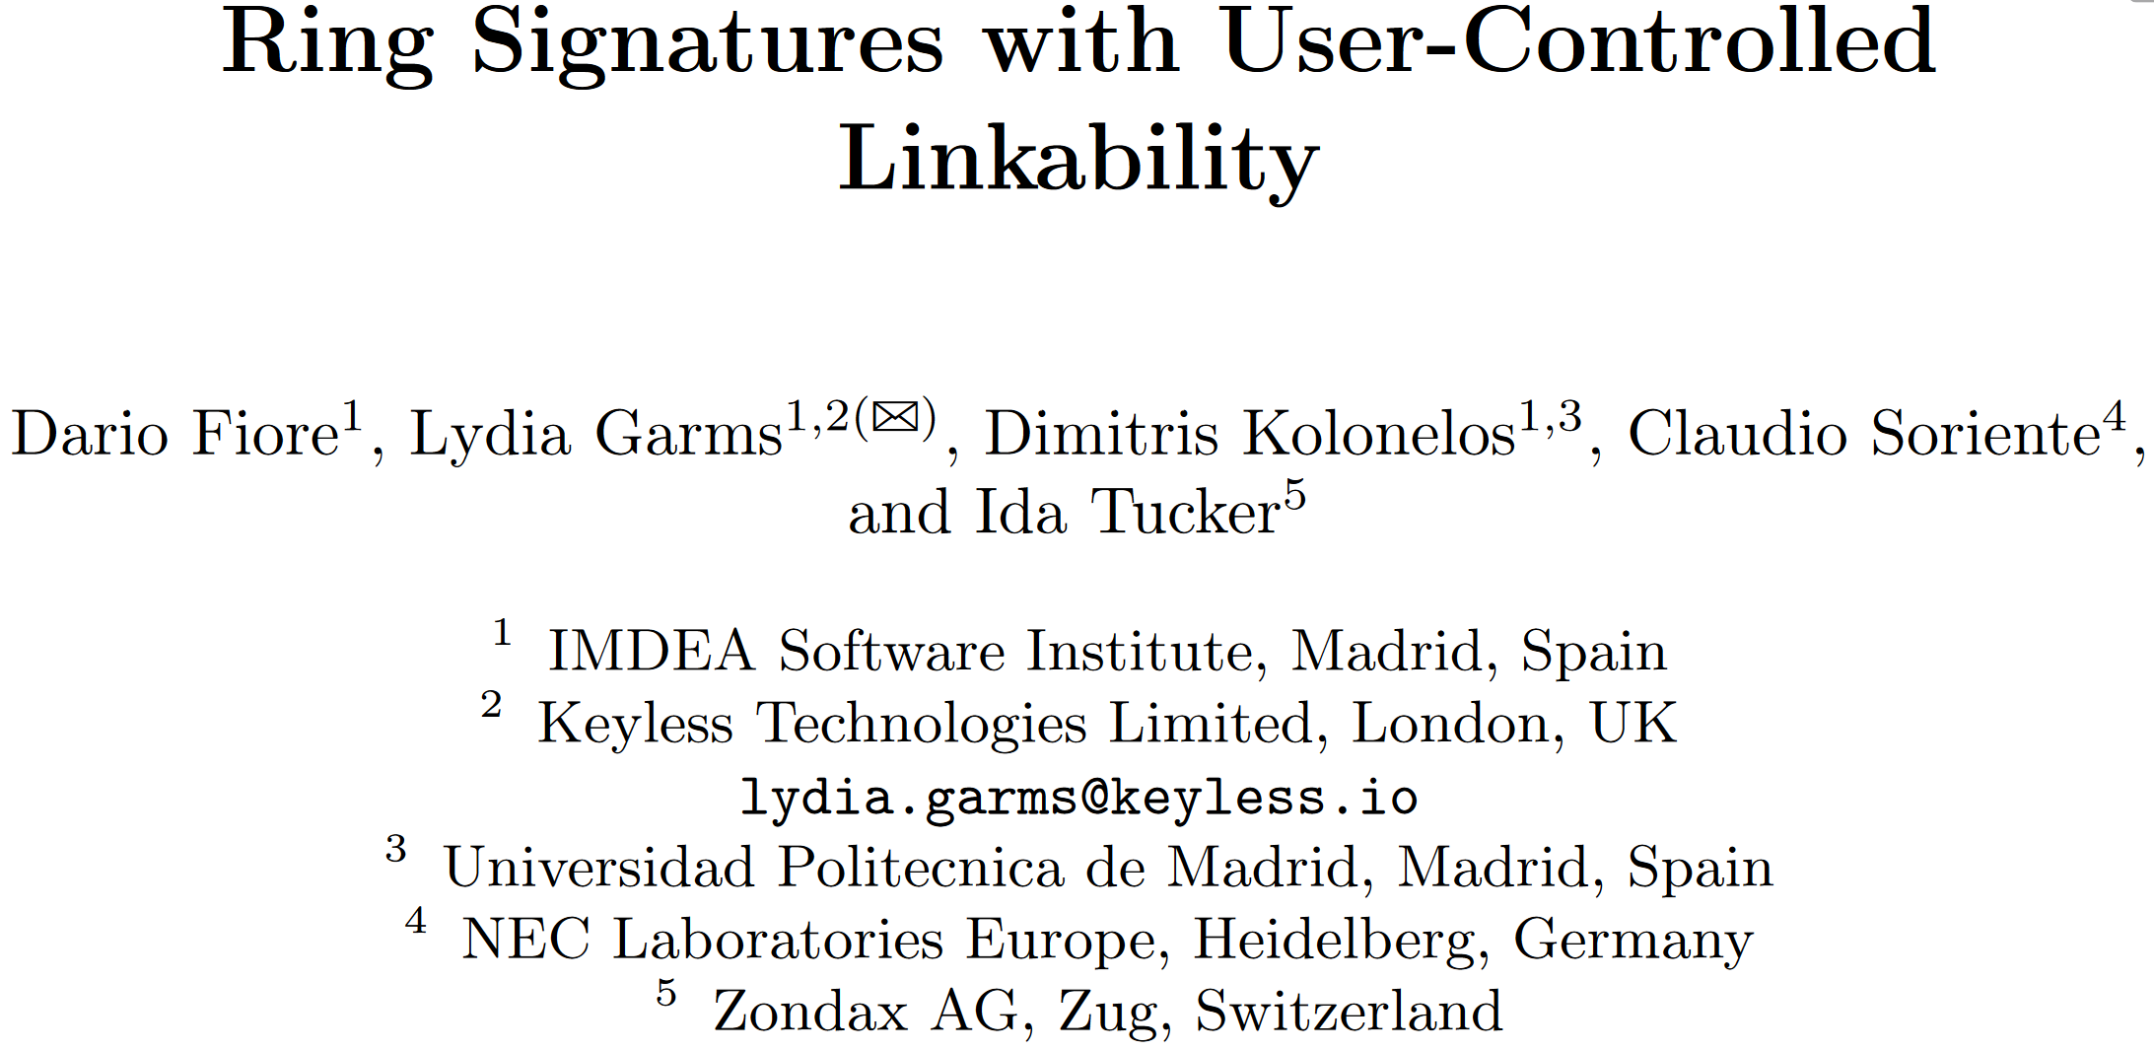
ESORICS 2023
王慧
2024.10.25

Slide 2
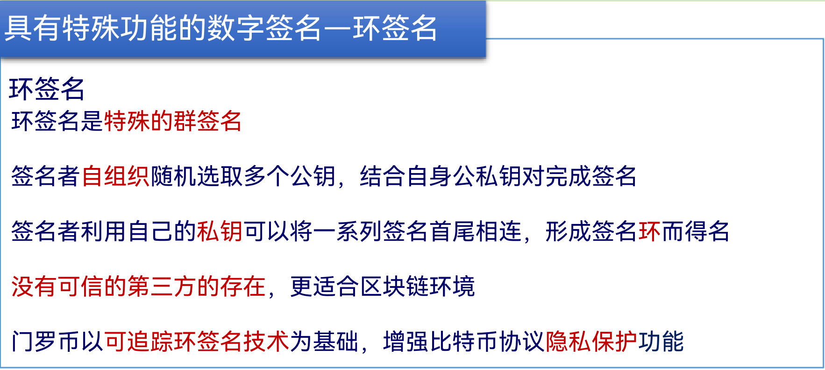
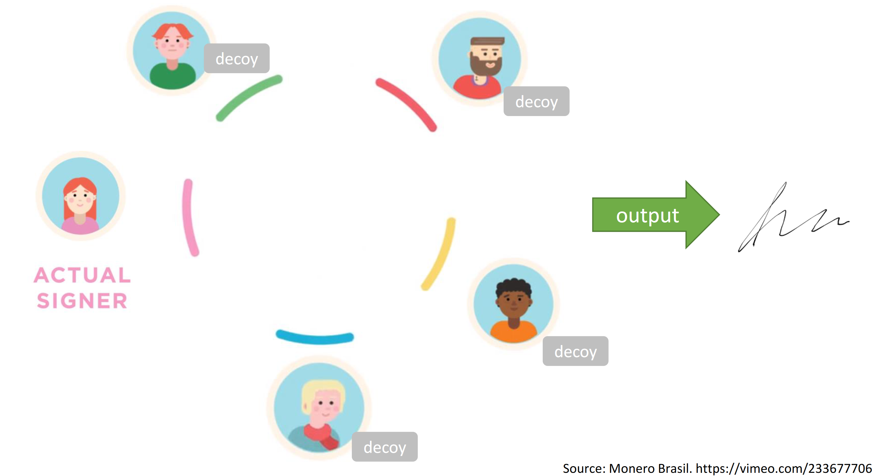
1.1Introduction - Ring Signatures

Slide 3
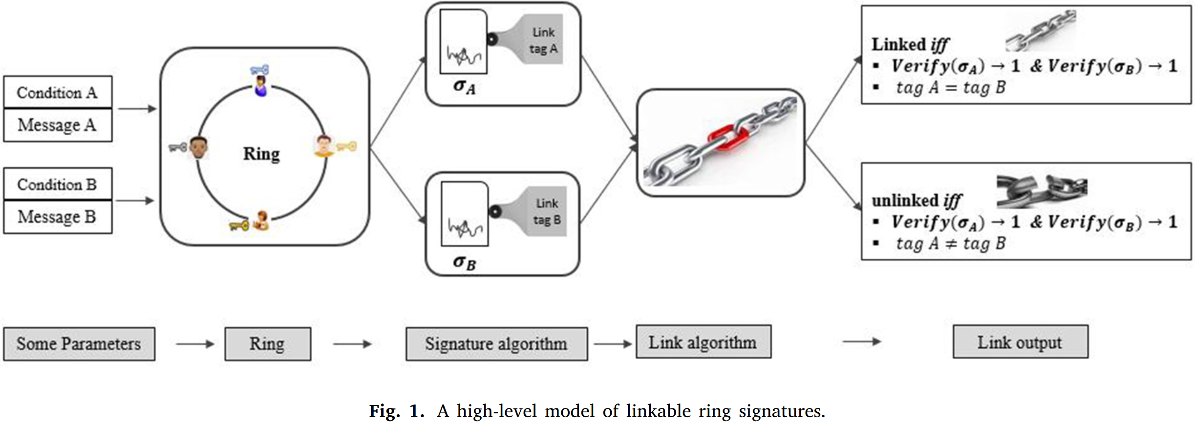
1.1Introduction - Ring Signatures

Slide 4
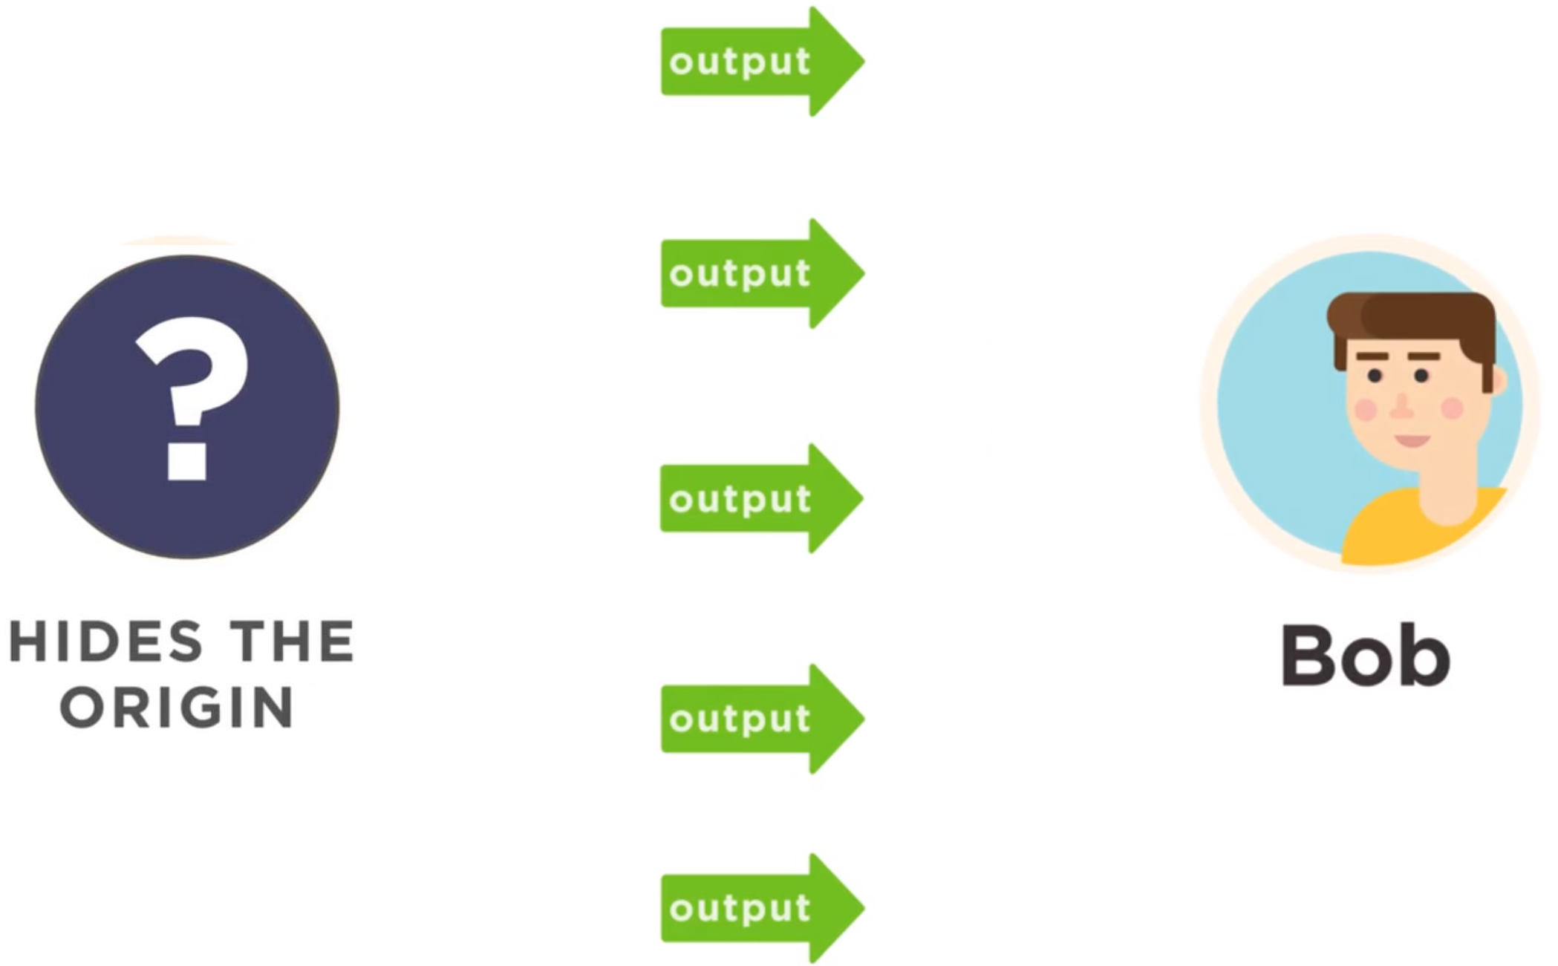
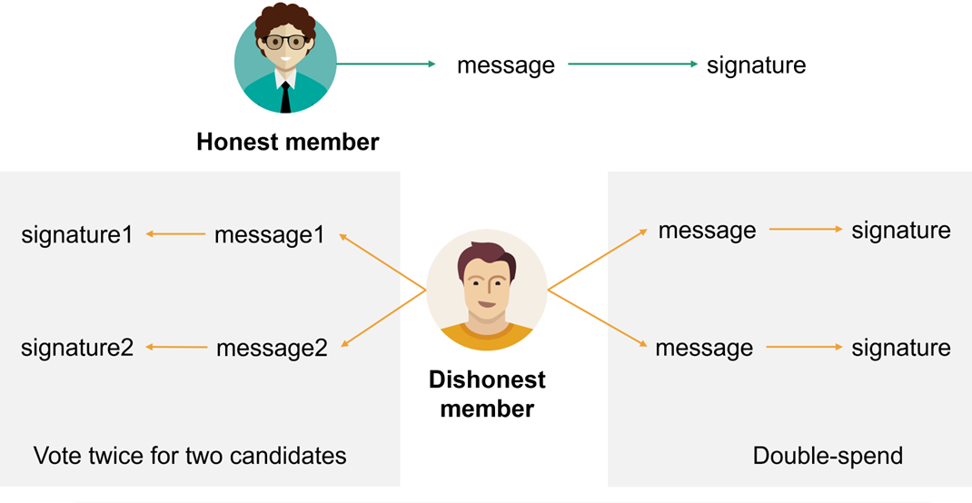
1.1Introduction - Ring Signatures
使用环签名保护发送方身份隐私和交易金额隐私
门罗币
电子投票

Slide 5
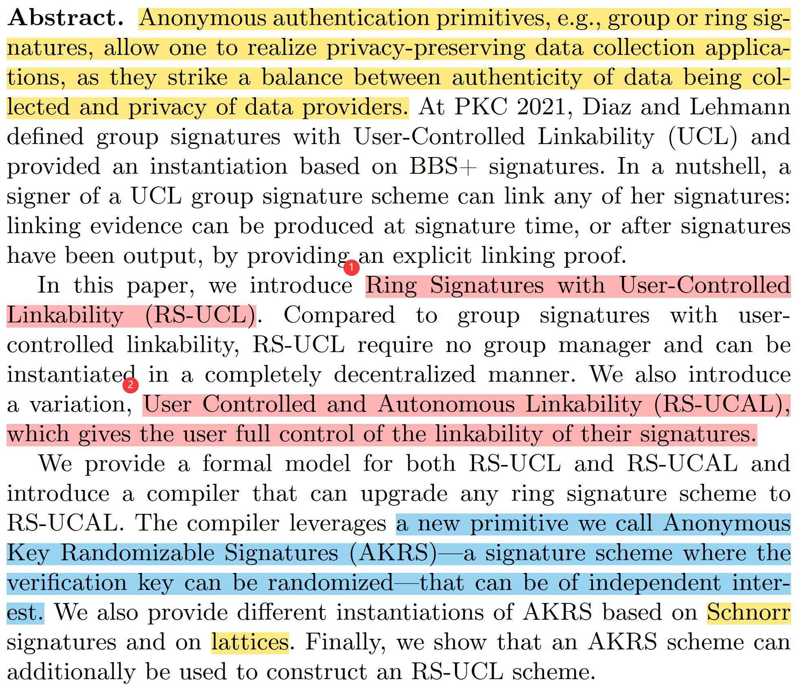
1.2Abstract

Slide 6
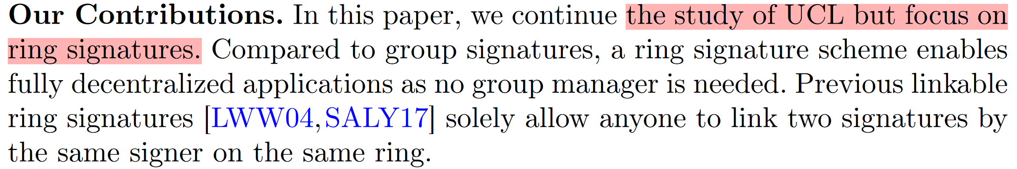
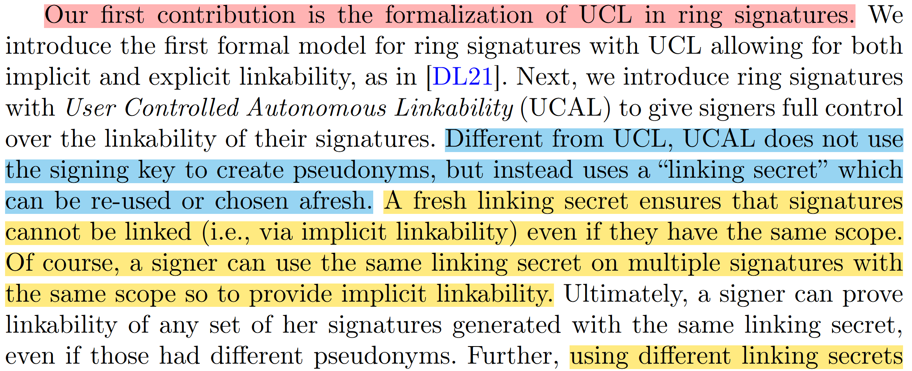
1.3Contributions
Notes:
形式化定义

Slide 7
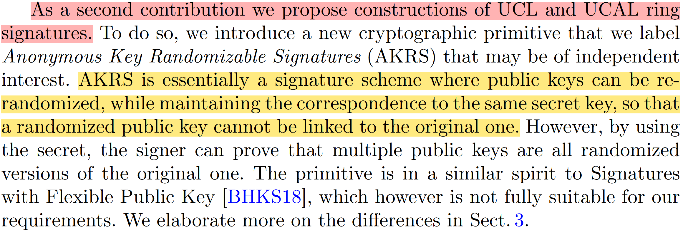
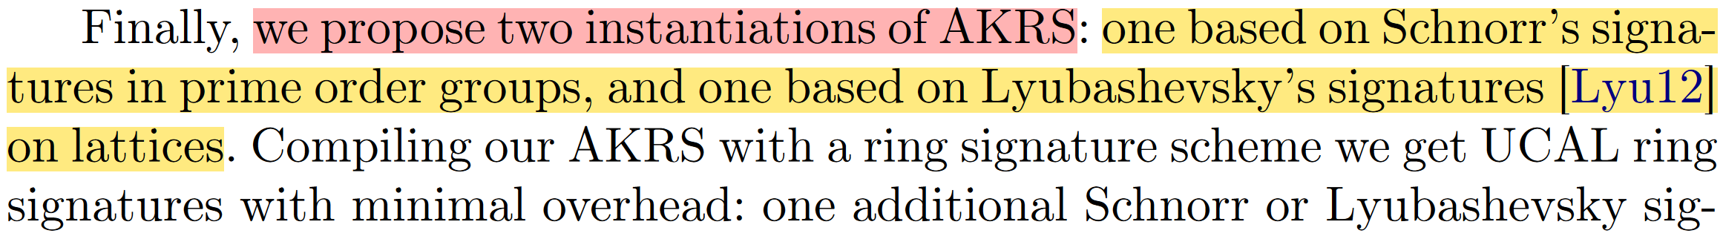
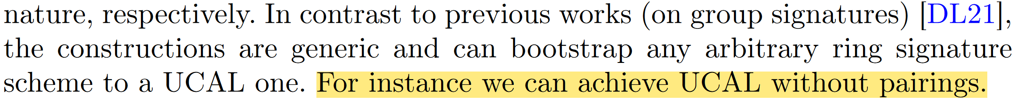
1.3Contributions

Slide 8
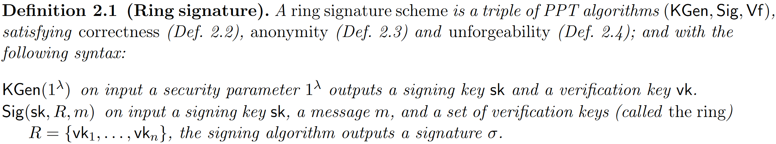
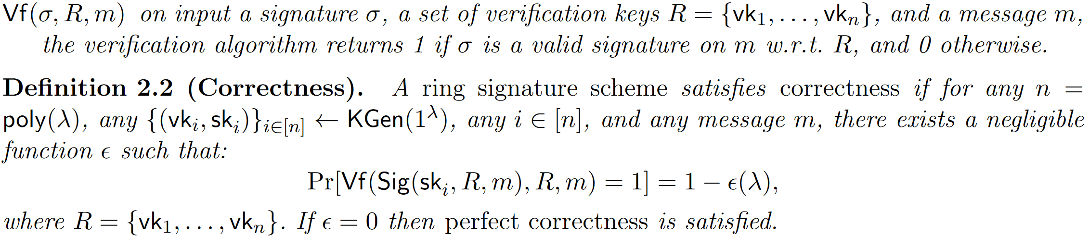
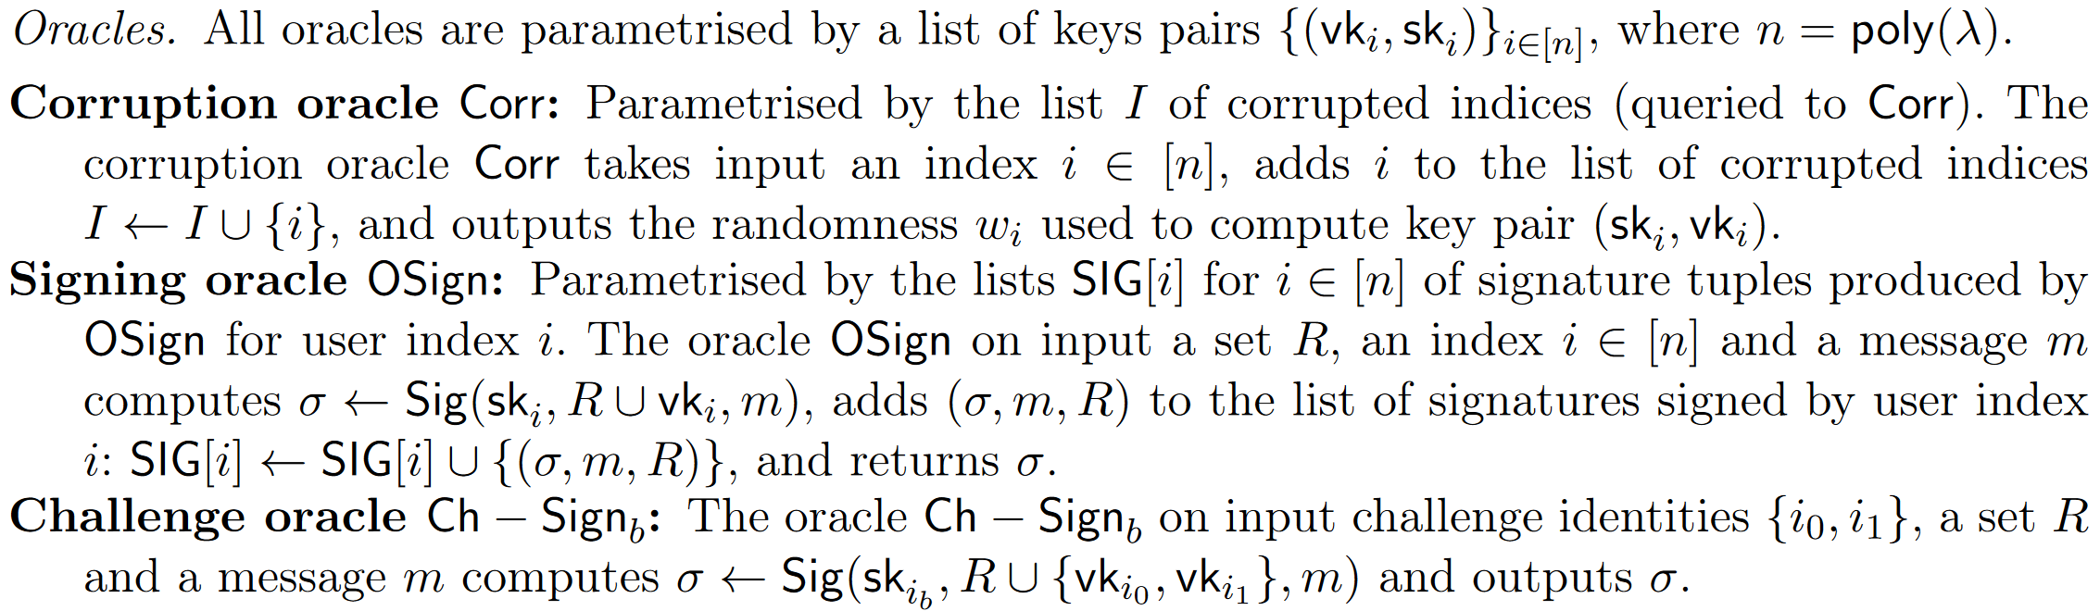
2.1Ring Signatures

Slide 9
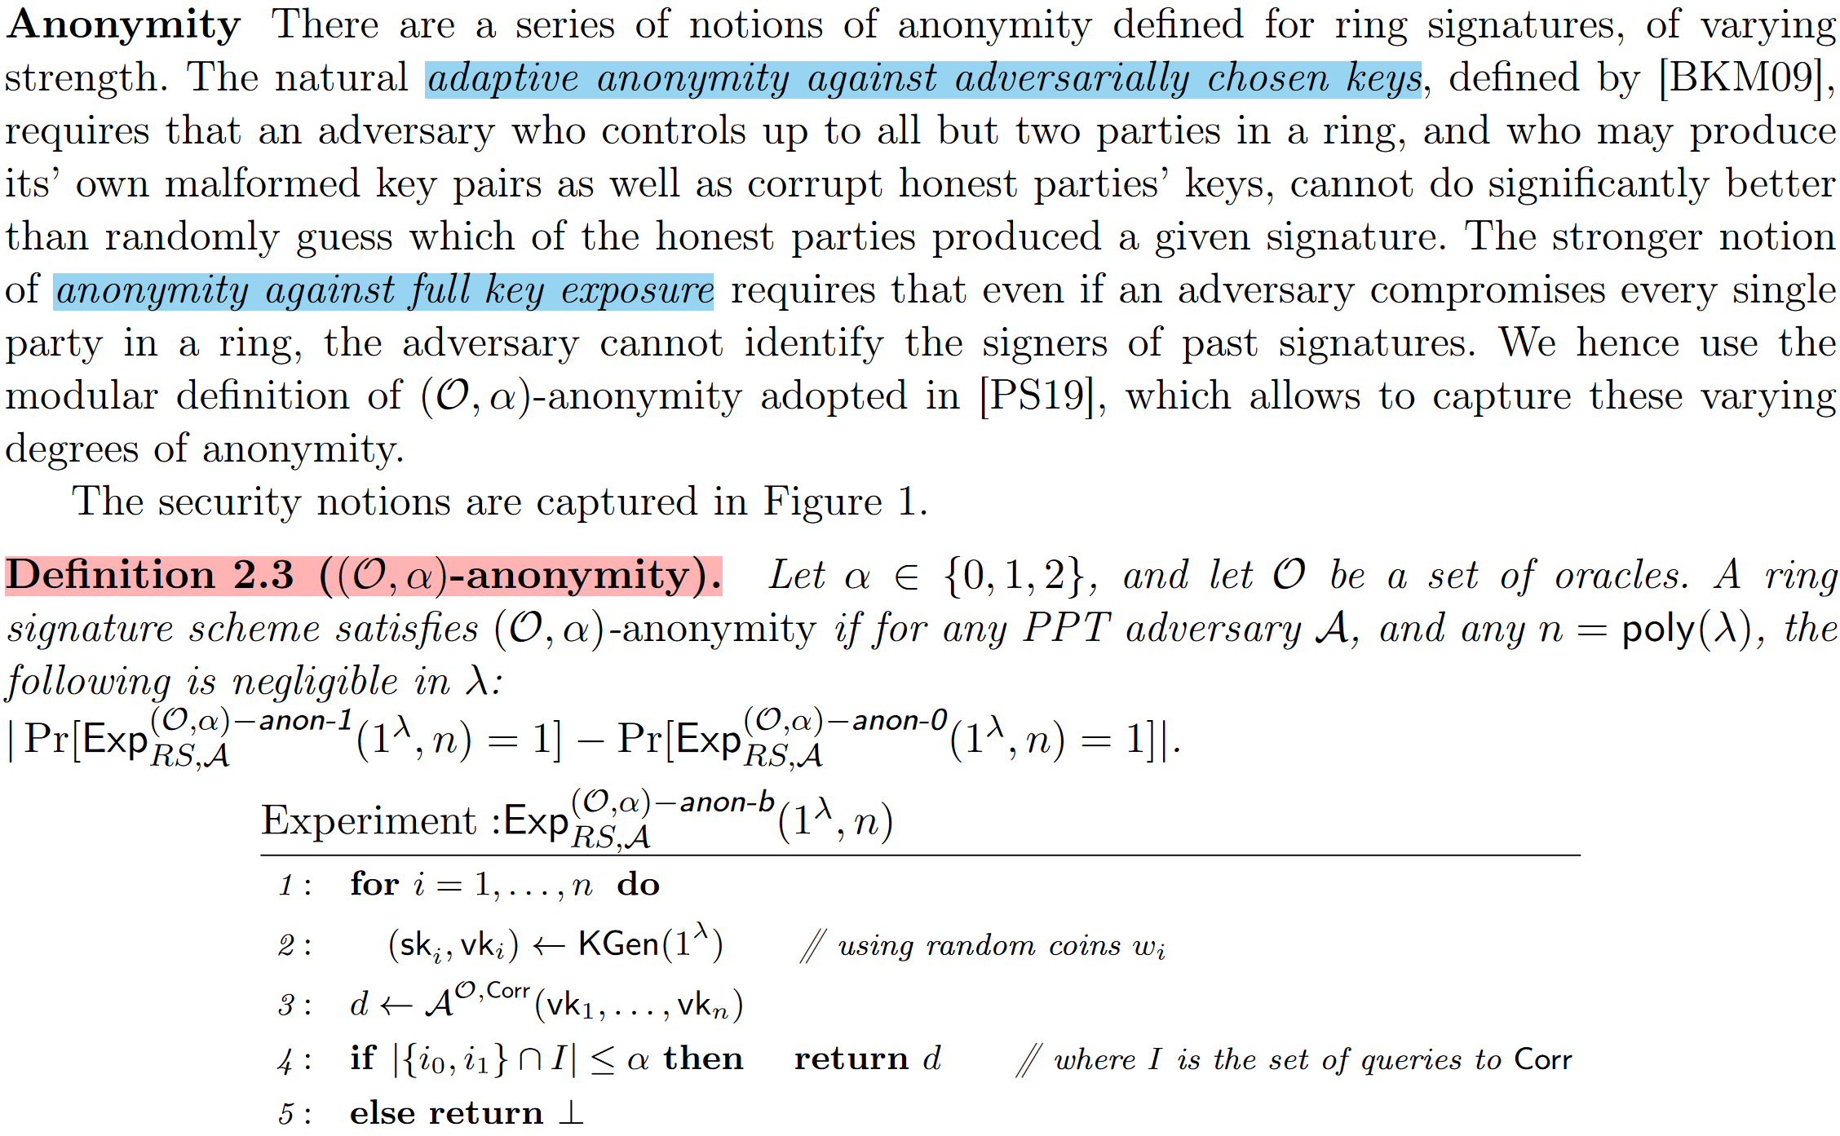
2.1Ring Signatures

Slide 10
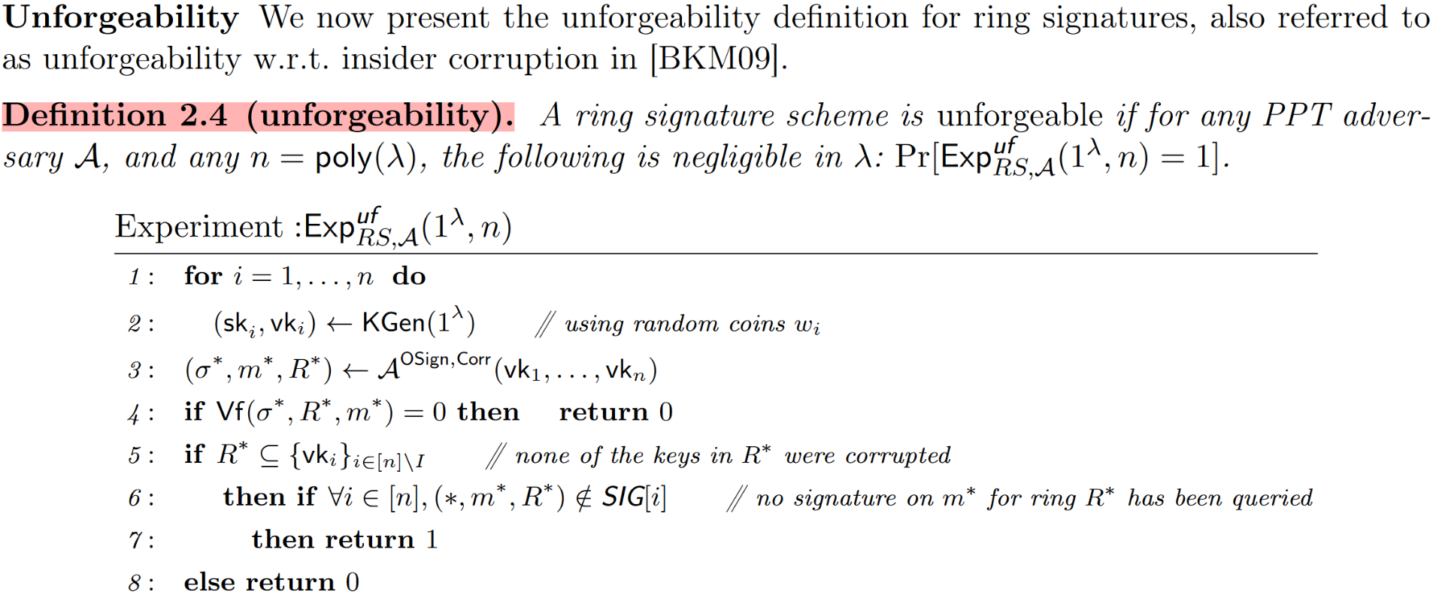
2.1Ring Signatures

Slide 11
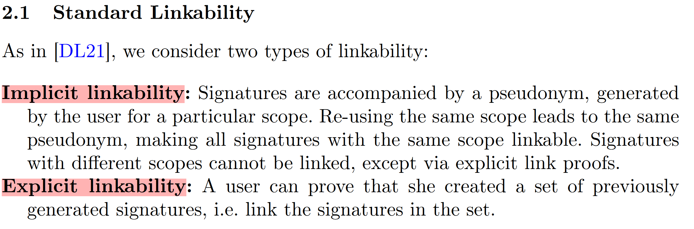
2.2Ring Signatures with User-Controlled Linkability

Slide 12
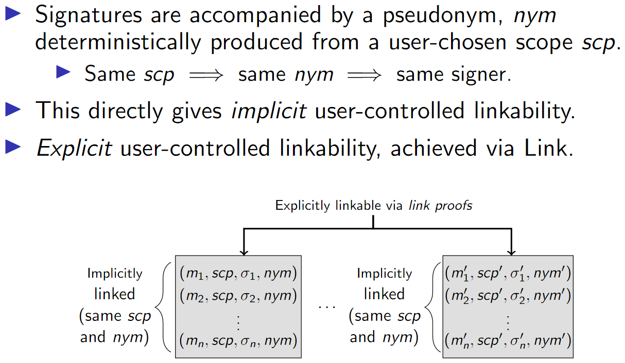
2.2Ring Signatures with User-Controlled Linkability

Slide 13
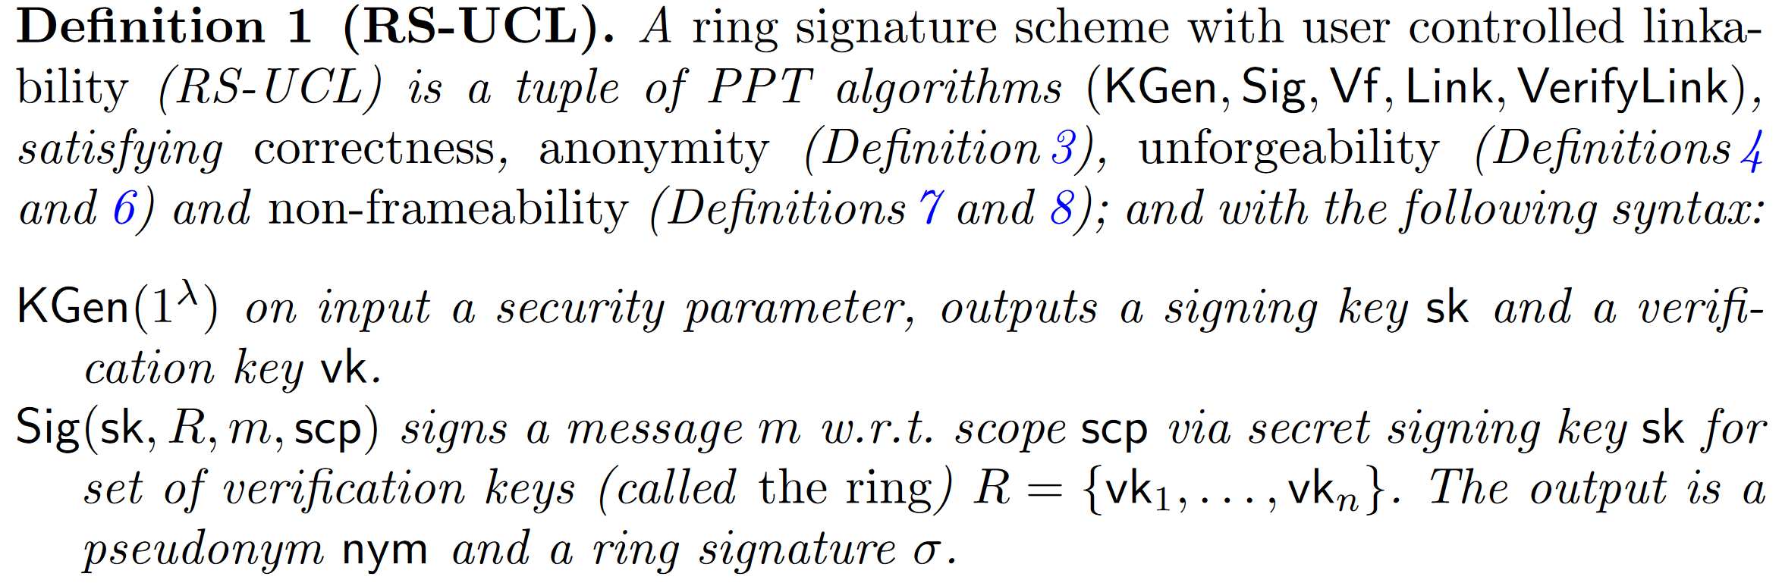
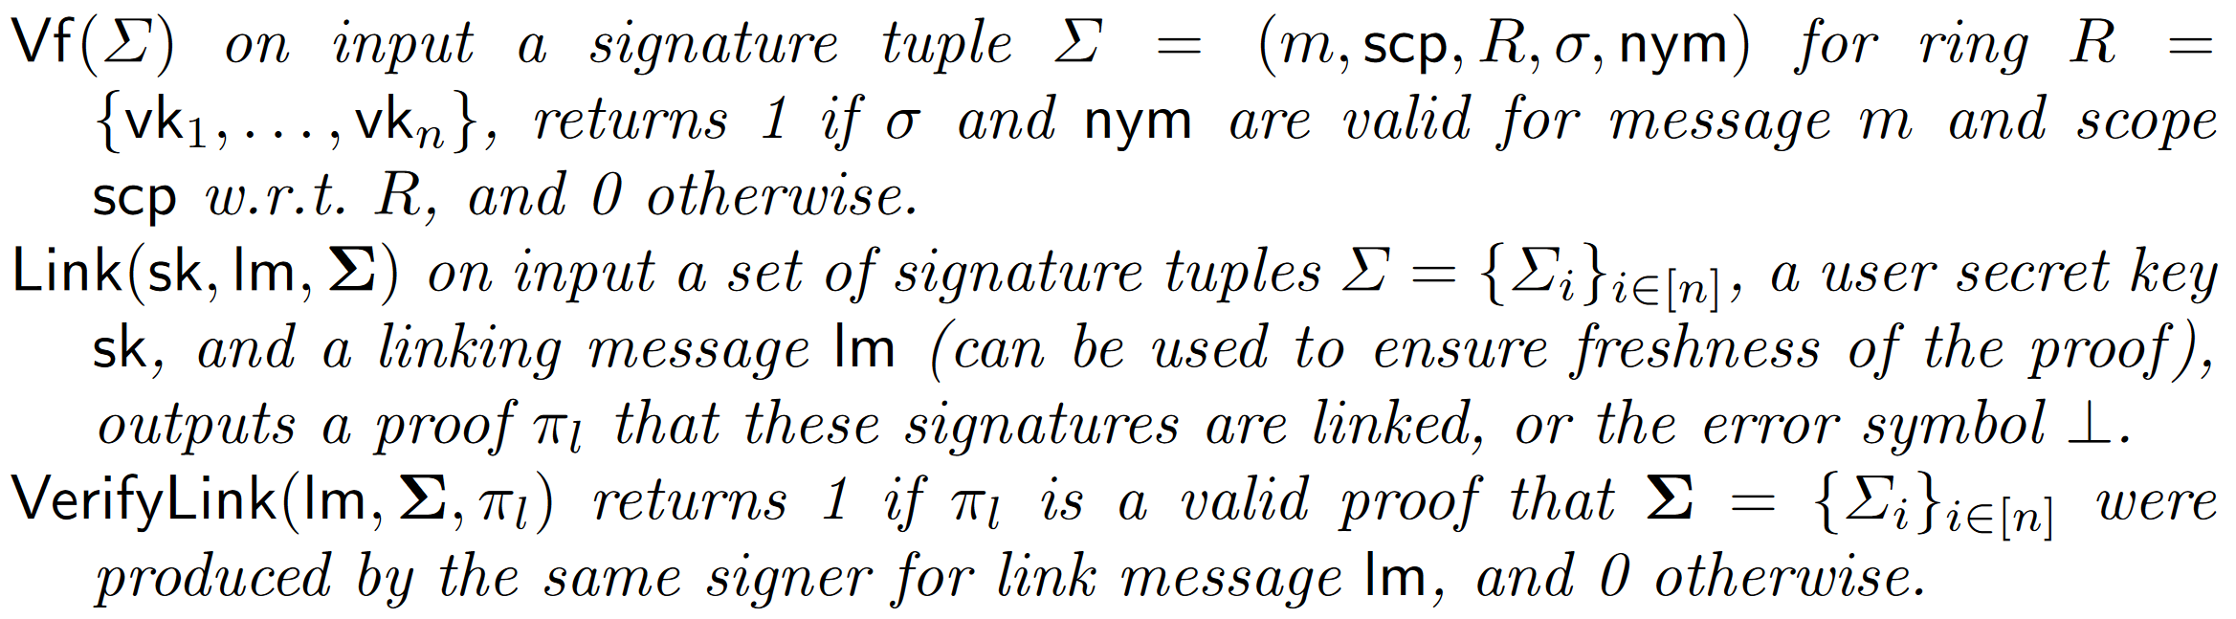
2.3 RS-UCL Definition

Slide 14
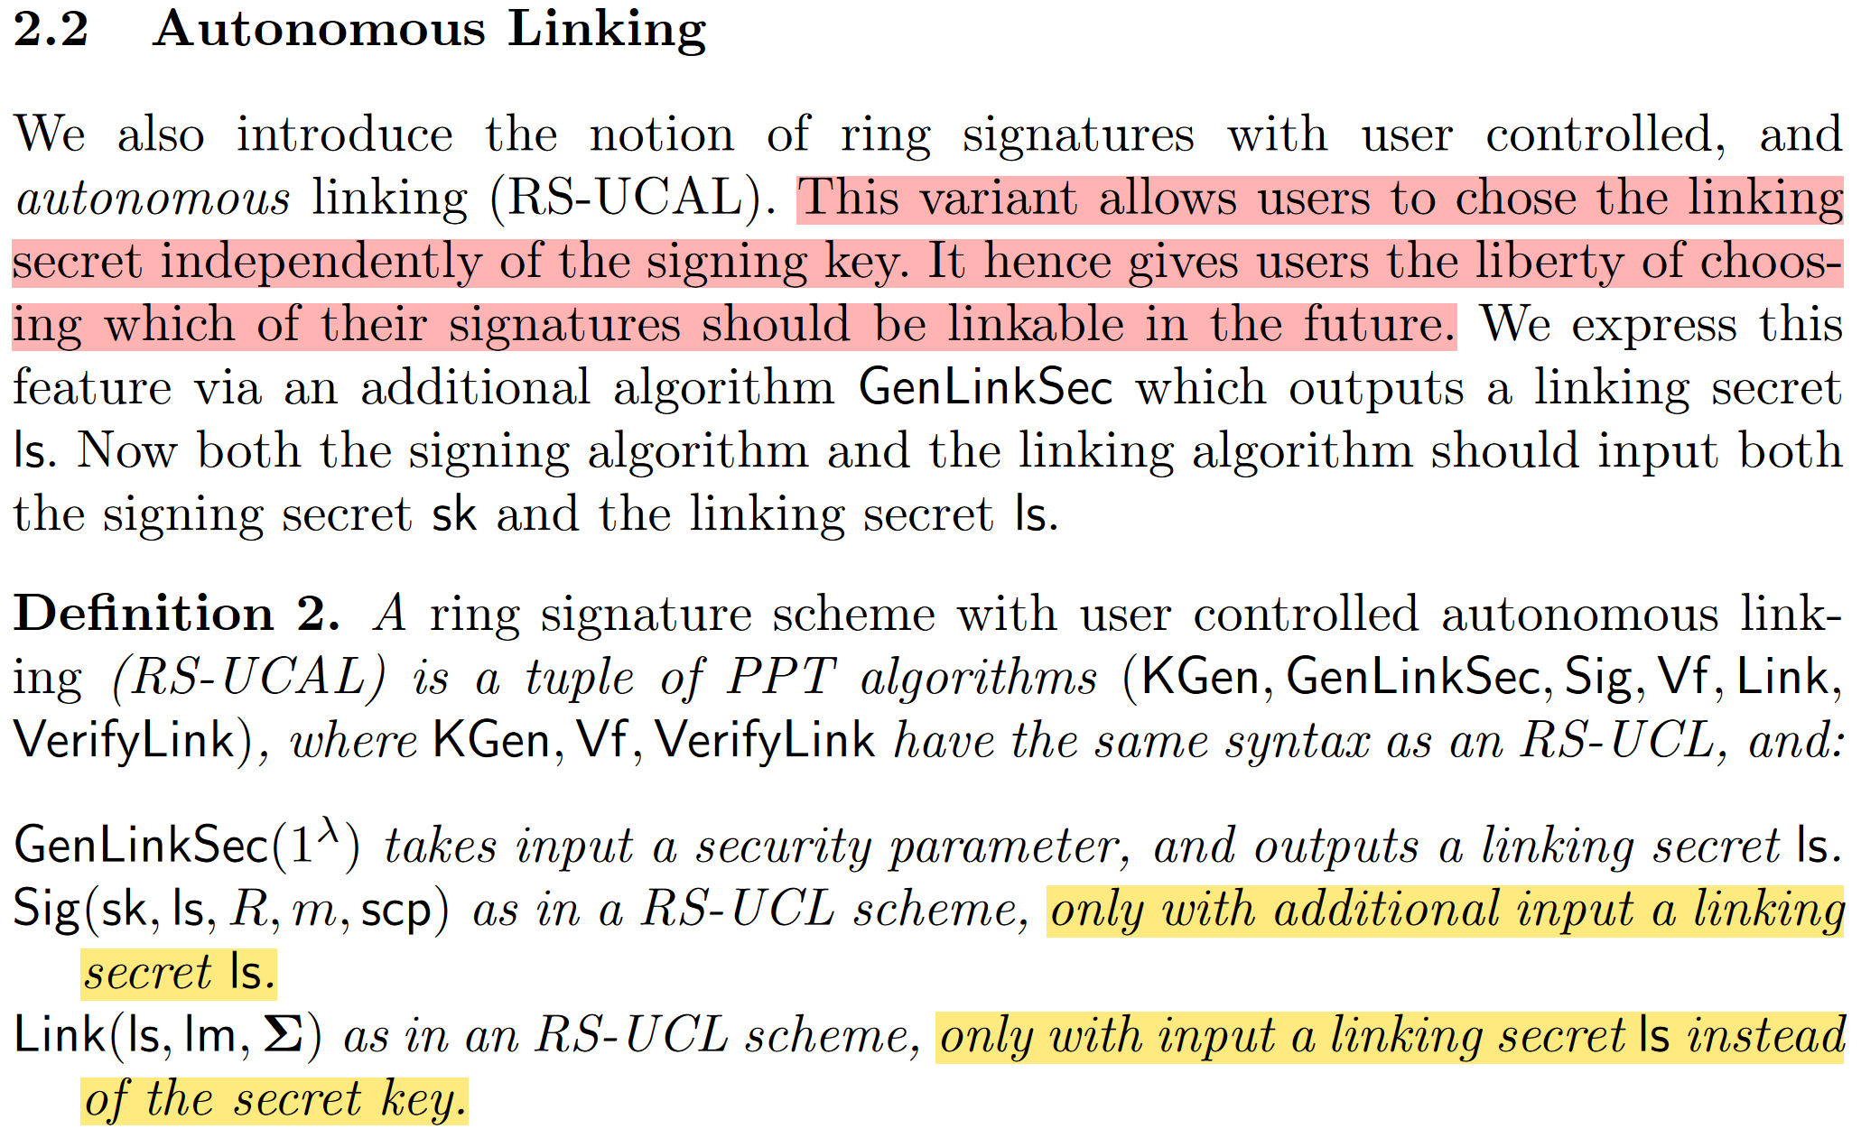
2.4 RS-UCAL Definition

Slide 15
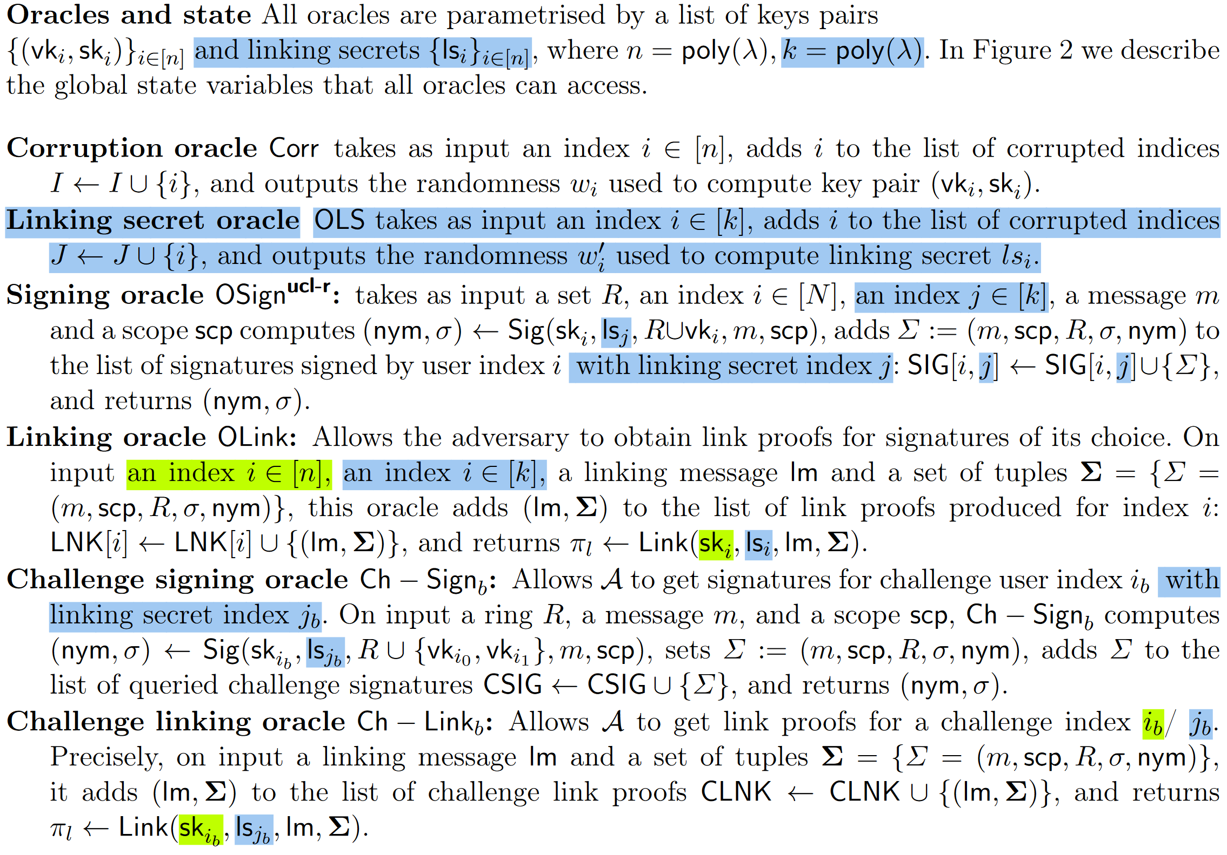
2.5 RS-UC(A)L Security Model
For privacy, signatures must not reveal anything about the signer’s identity beyond what was intended by her (anonymity). Security is expressed through both unforgeability, which ensures that an adversary cannot forge a signature on behalf of a ring they are not a member of or forge a link proof for signatures they did not generate, and non-frameability, which states that an honest user cannot be framed by the adversary, so that signatures of an honest user are (implicitly or explicitly) linkable to signatures that she has not generated.

Slide 16
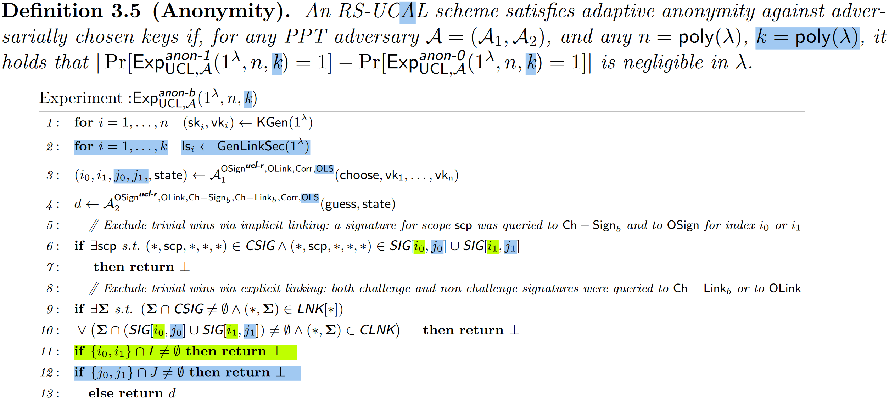
2.5 RS-UC(A)L Security Model -- Anonymity

Slide 17
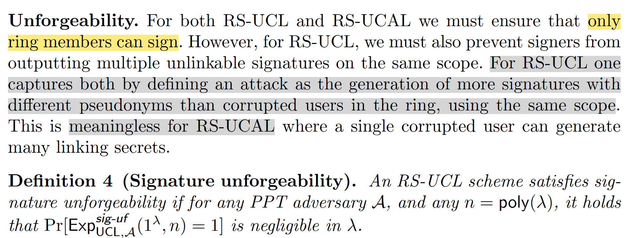
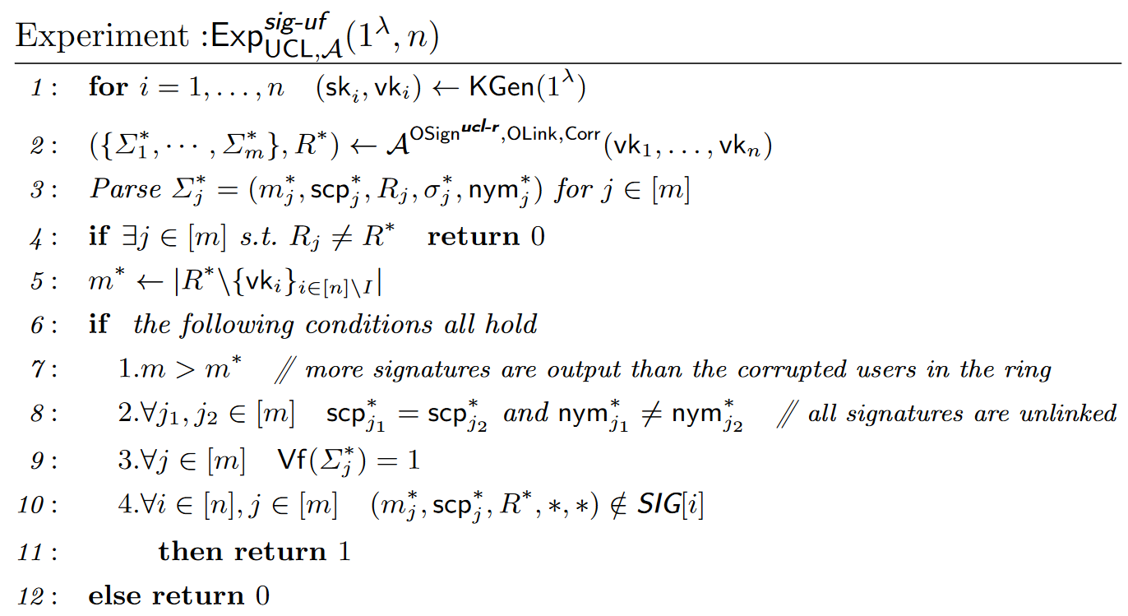
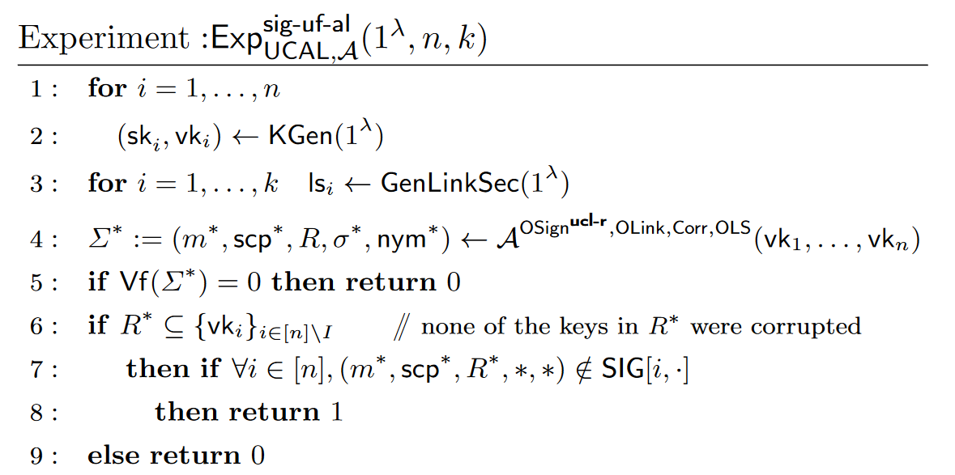
2.5 RS-UC(A)L Security Model -- Unforgeability
a similar notion of (signature) unforgeability as that of standard ring signatures, with the difference that the adversary also has access to a linking oracle.

Slide 18
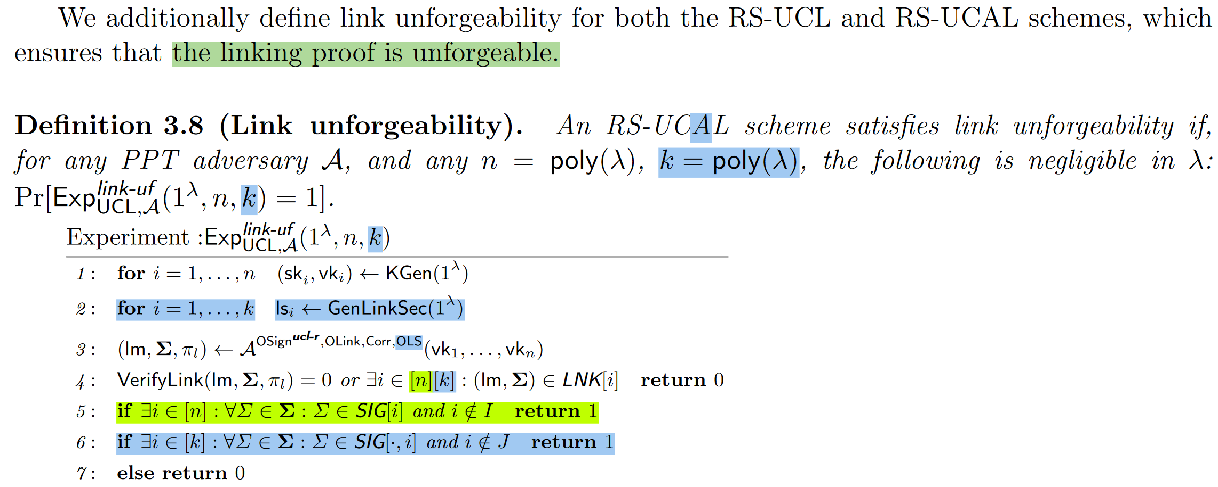
2.5 RS-UC(A)L Security Model -- Unforgeability

Slide 19
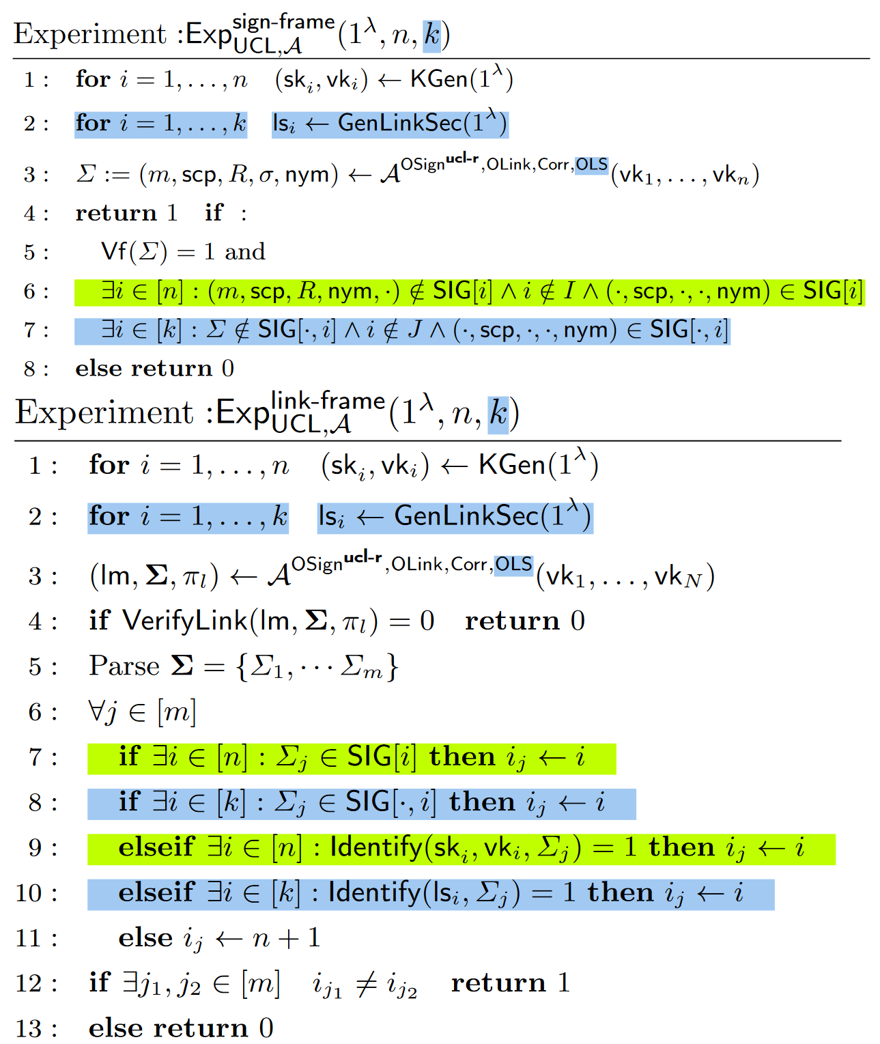
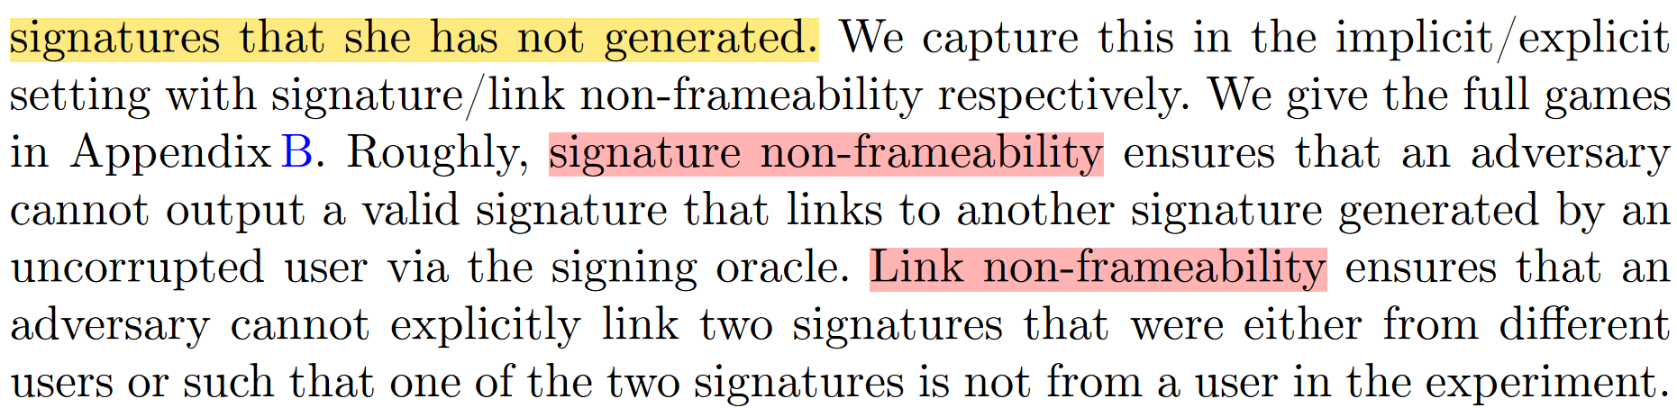
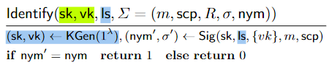
2.5 RS-UC(A)L Security Model – Non-frameability

Slide 20
correctness
$$\operatorname{Pr}\left[Vf\left(Sig\left(sk_{i},R,m\right),R,m\right)=1\right]=1 − ε(λ)$$
Adaptive anonymity against adversarially chosen keys
Ring Signature
anonymity
Anonymity against full key exposure
unforgeability
Only ring members can sign (For RS-UCL one captures both by defining an attack as the generation of more signatures with different pseudonyms than corrupted users in the ring, using the same scope)
correctness
An adversary cannot figure out which of two (honest) challenge users generated a given signature
anonymity
Signature unforgeability
RS-UCL
unforgeability
Link unforgeability
Non-frameability
Signature non-frameability
Link non-frameability
correctness
anonymity
Signature unforgeability
RS-UCAL
unforgeability
Link unforgeability
Non-frameability
Signature non-frameability
Link non-frameability

Slide 21
correctness
$$\operatorname{Pr}\left[Vf\left(Sig\left(sk_{i},R,m\right),R,m\right)=1\right]=1 − ε(λ)$$
Adaptive anonymity against adversarially chosen keys
Ring Signature
anonymity
Anonymity against full key exposure
unforgeability
Only ring members can sign (For RS-UCL one captures both by defining an attack as the generation of more signatures with different pseudonyms than corrupted users in the ring, using the same scope)
correctness
An adversary cannot figure out which of two (honest) challenge users generated a given signature
AKRS为class hiding, accumulation sound; NIZK为zero knowledge
anonymity
Signature unforgeability: AKRS为class hiding, NIZK为simulation sound extractable
RS-UCL
unforgeability
Link unforgeability: AKRS为unforgeable
Non-frameability
Signature non-frameability: AKRS为unforgeable, NIZK为simulation sound extractable
Link non-frameability: AKRS为accumulation sound
correctness
anonymity
AKRS为Class hiding, unforgeable; RS为adaptive anonymity against adversarially chosen keys
RS-UCAL
Signature unforgeability: RS unforgeable
unforgeability
Link unforgeability: AKRS unforgeable
Non-frameability
Signature non-frameability: AKRS unforgeable
Link non-frameability: AKRS accumulation sound

Slide 22
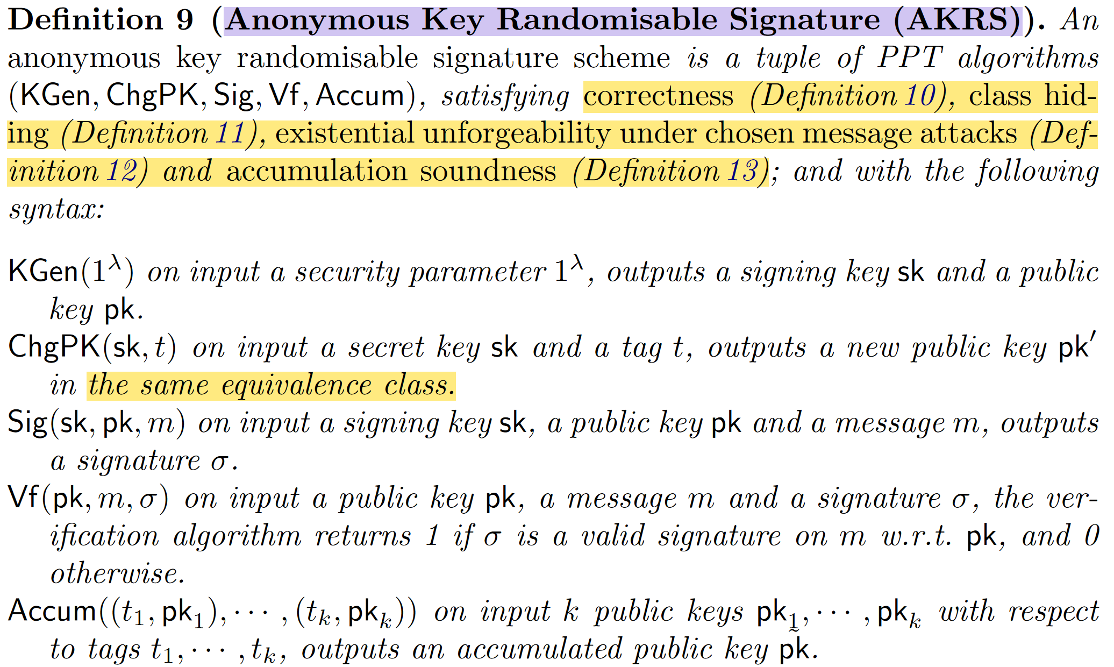
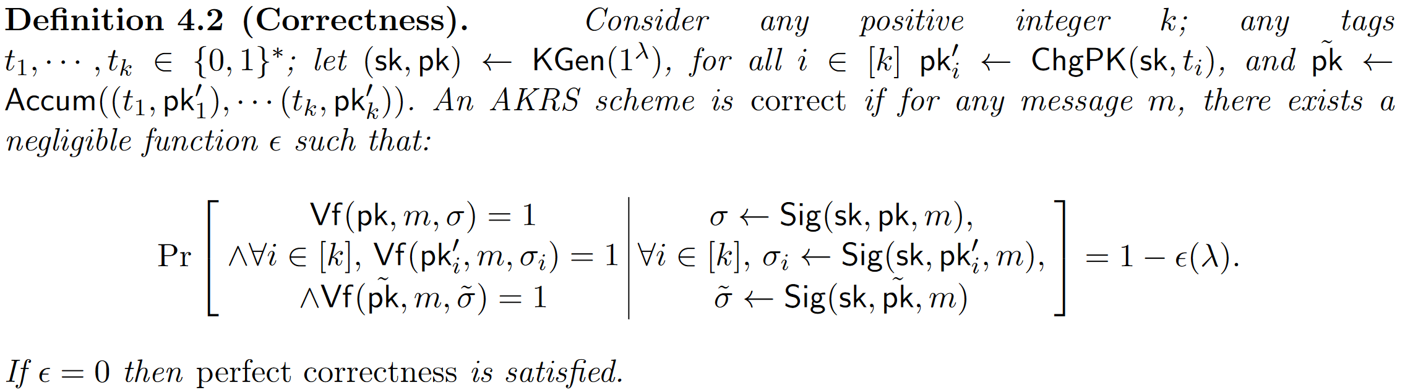
3 AKRS
we allow for several key pairs in the same equivalence class to be accumulated into one key pair.

Slide 23
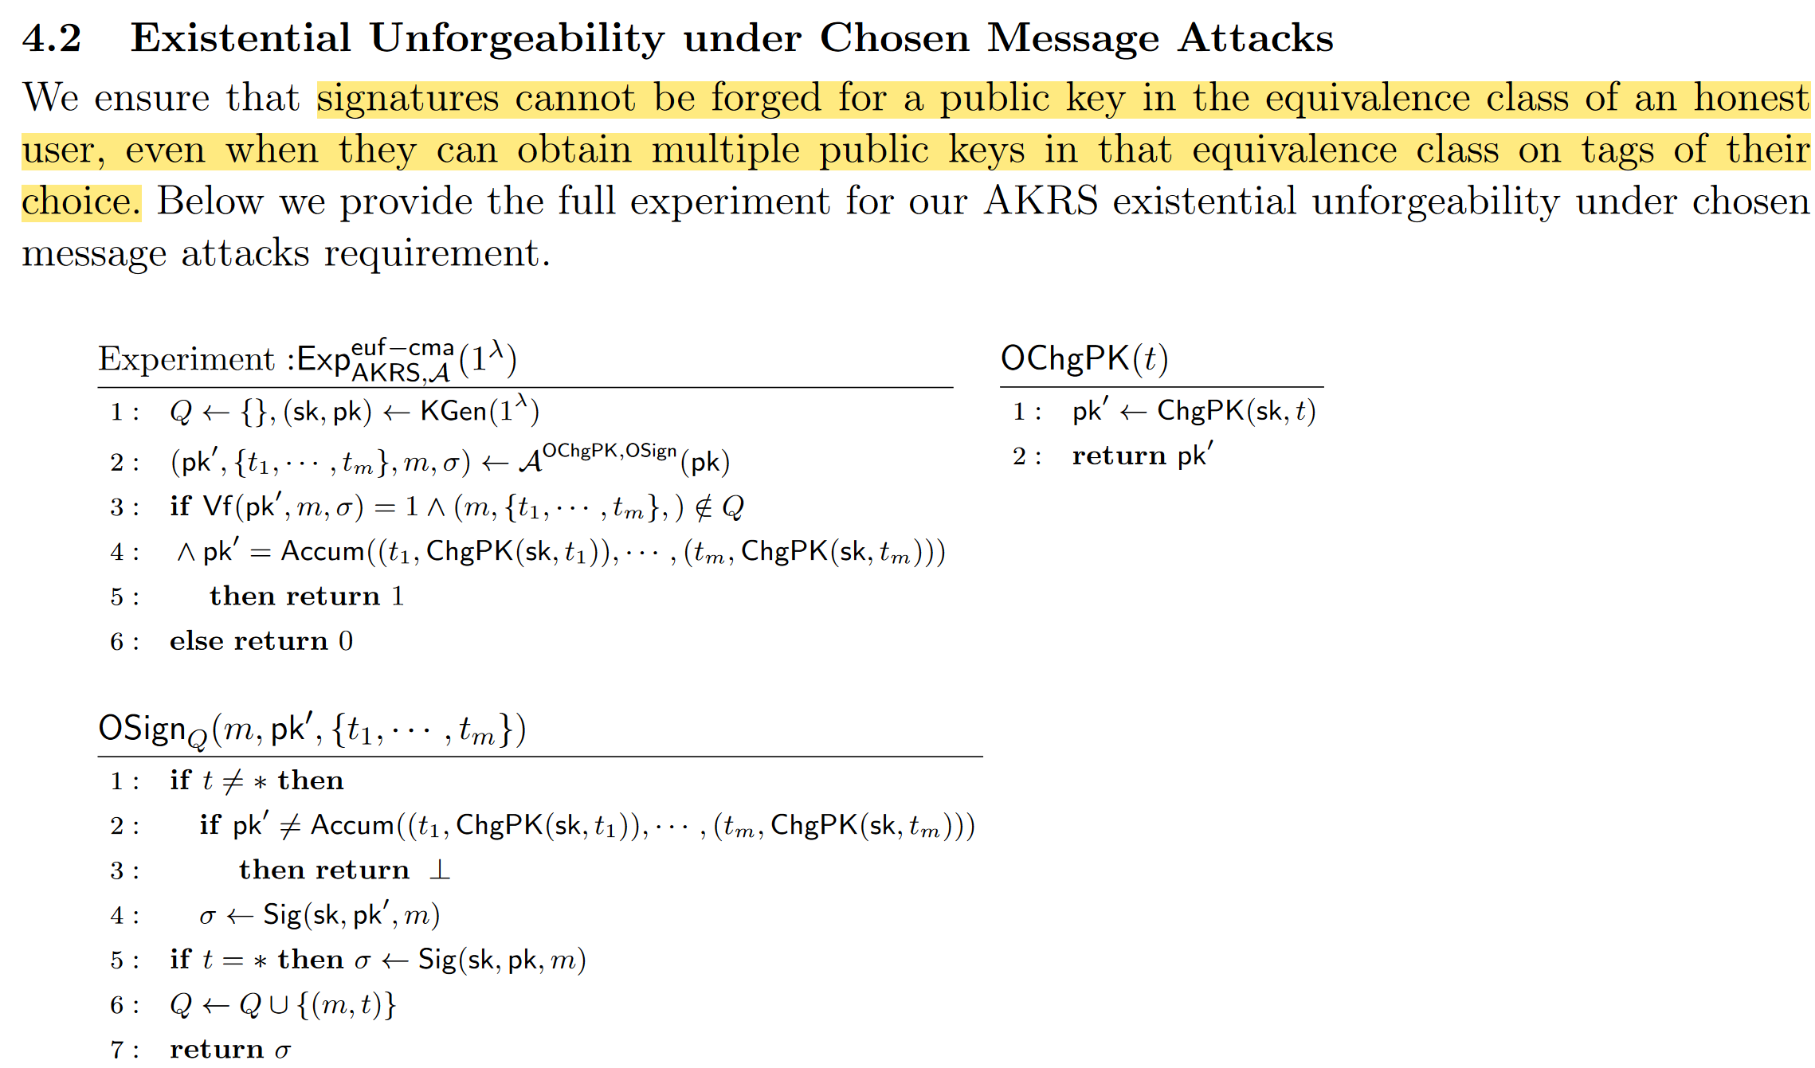
3.1 AKRS

Slide 24
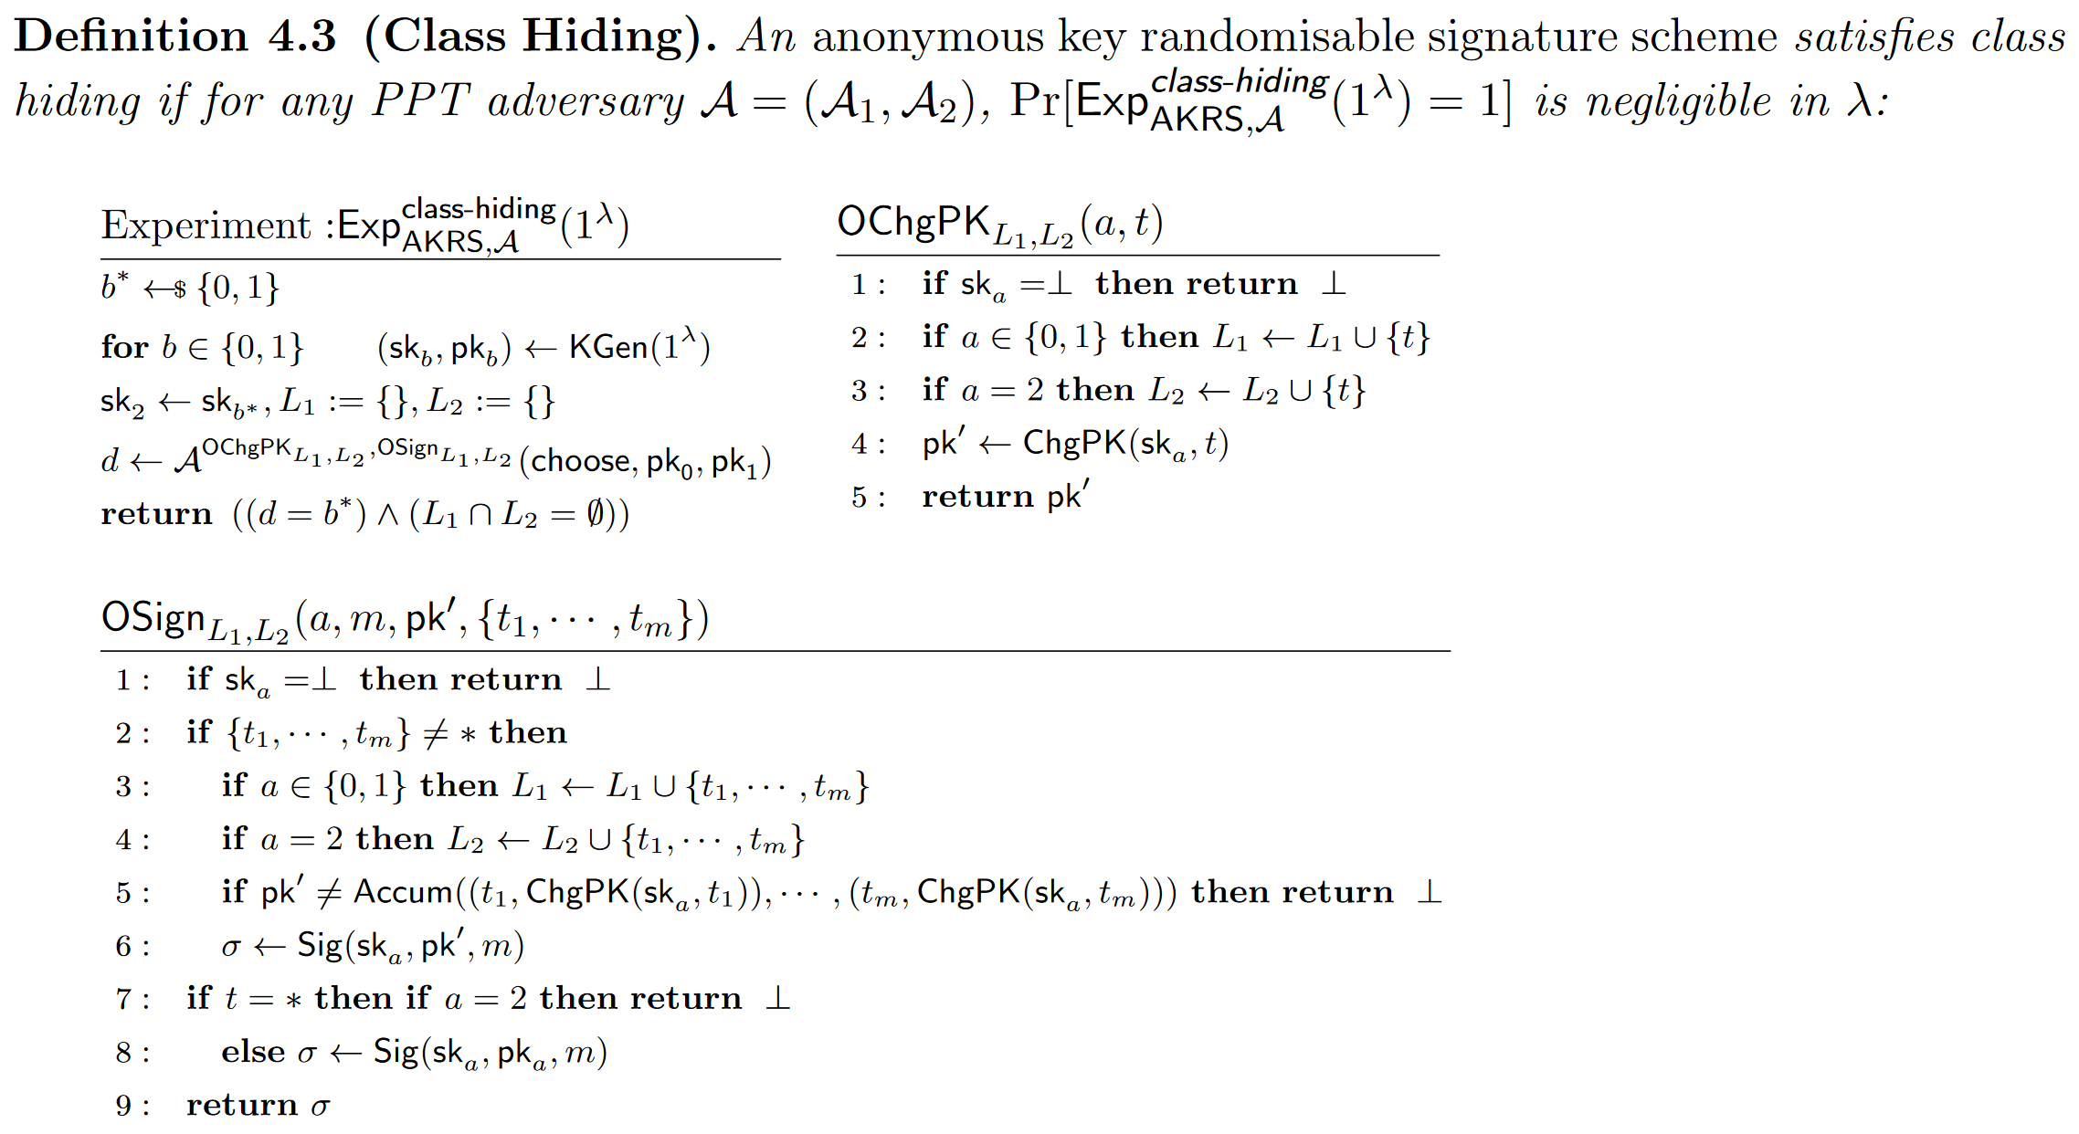
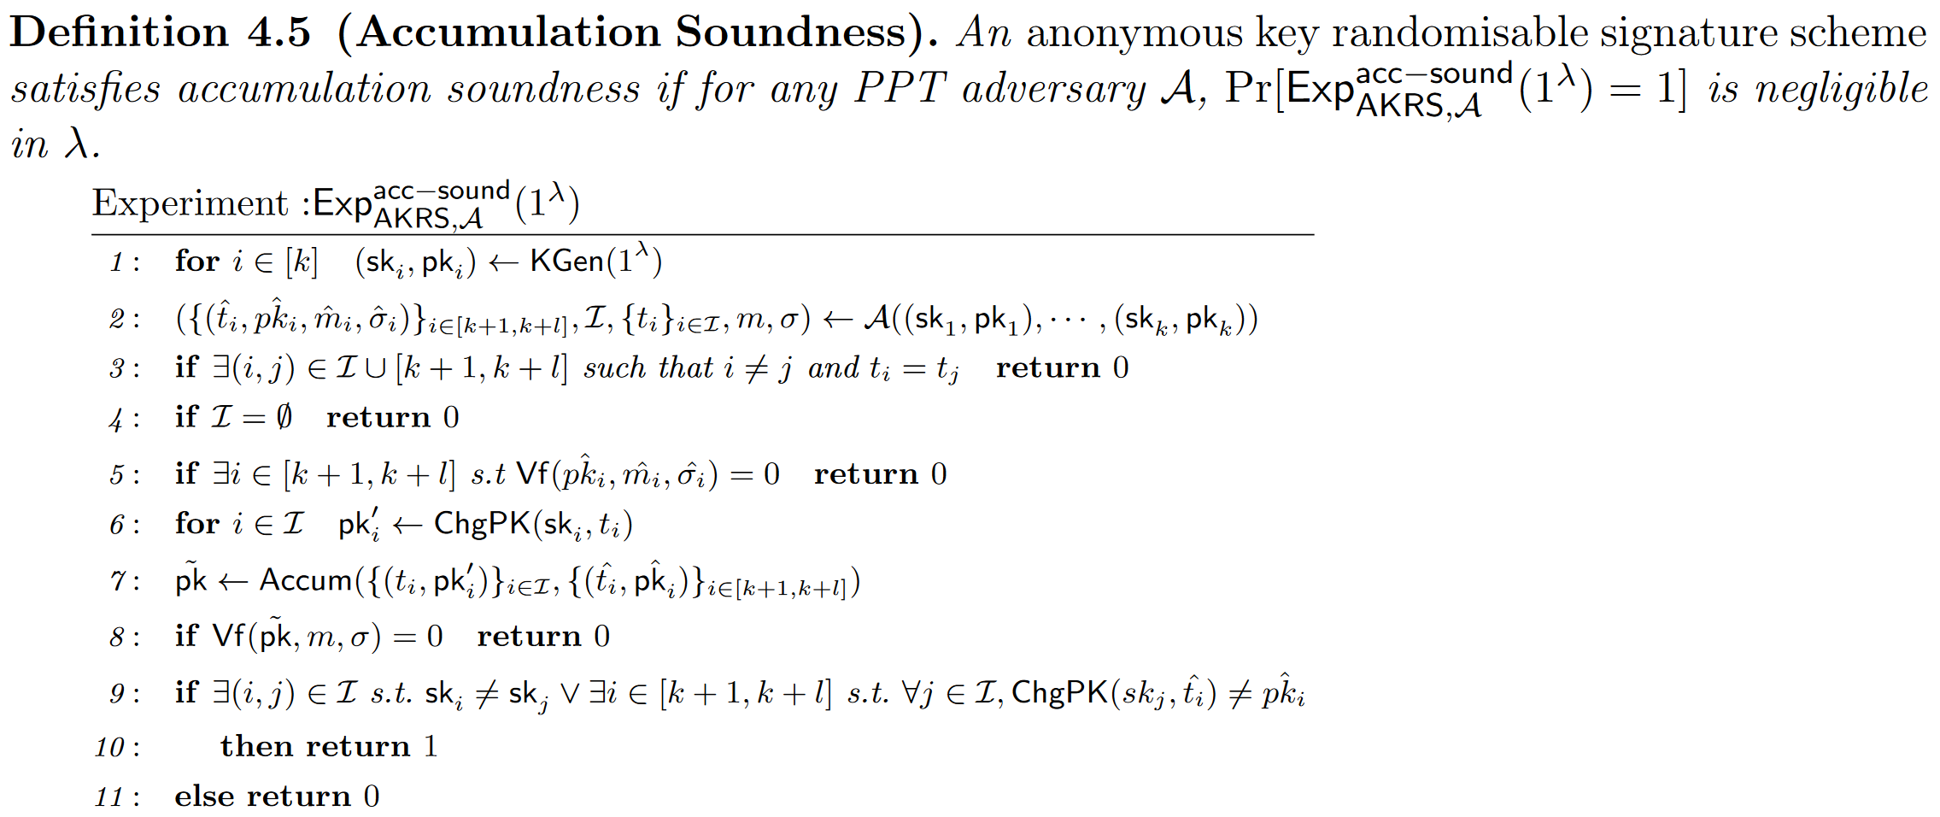
3.2 AKRS
Class Hiding：an adversary cannot guess which of two public keys are re-randomised with a tag chosen by the adversary (through oracle OChgPK), even while they can obtain signatures on these public keys and the re-randomised keys (via the OSign oracle).
Accumulation Soundness：This is a new requirement necessary due to the accumulation functionality. It must not be possible to produce a signature which verifies for an accumulated public key, if the public keys input to the accumulation algorithm do not belong to the same equivalence class.

Slide 25
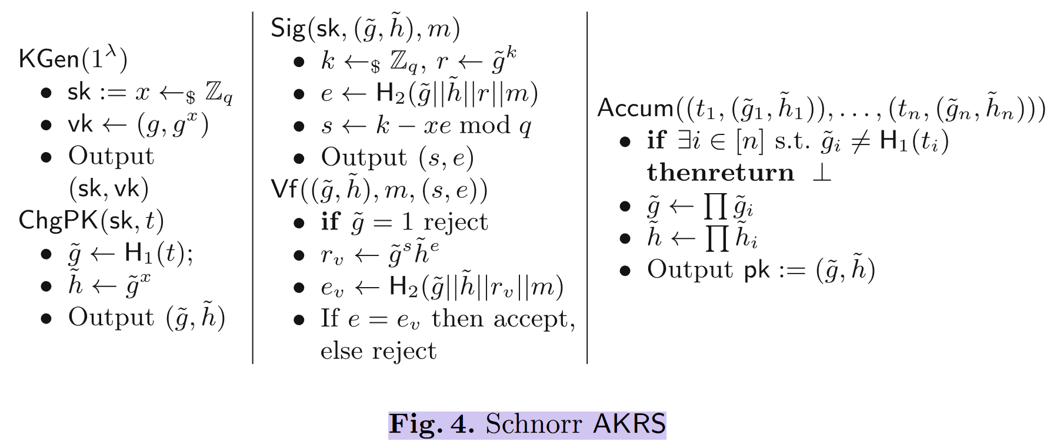
3.3 AKRS Instantiations—Construction from Schnorr Signatures

Slide 26
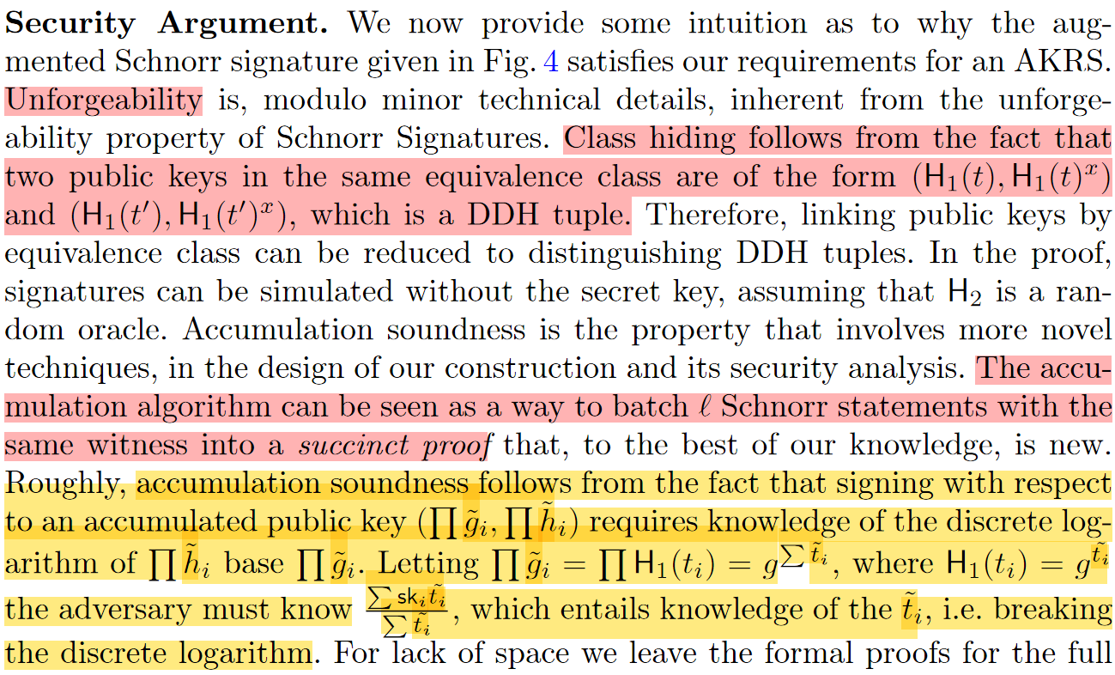
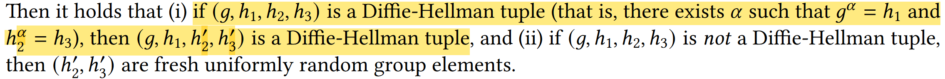
3.3 AKRS Instantiations—Construction from Schnorr Signatures
DDH tuples

Slide 27
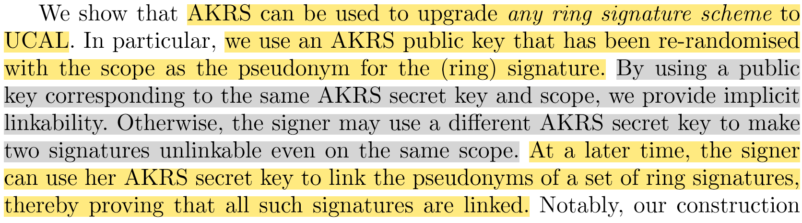
4.Ring Signatures with User-Controlled Linkability

Slide 28
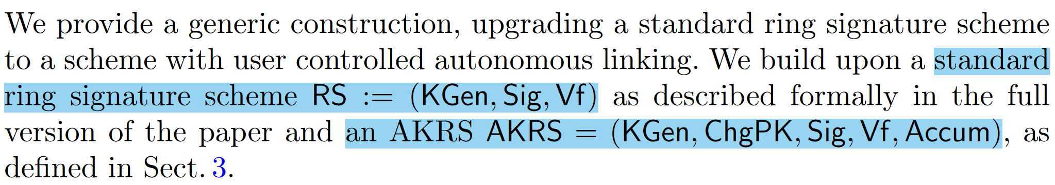
4.1RS-UCAL
构造一： RS with user controlled autonomous linking

Slide 29
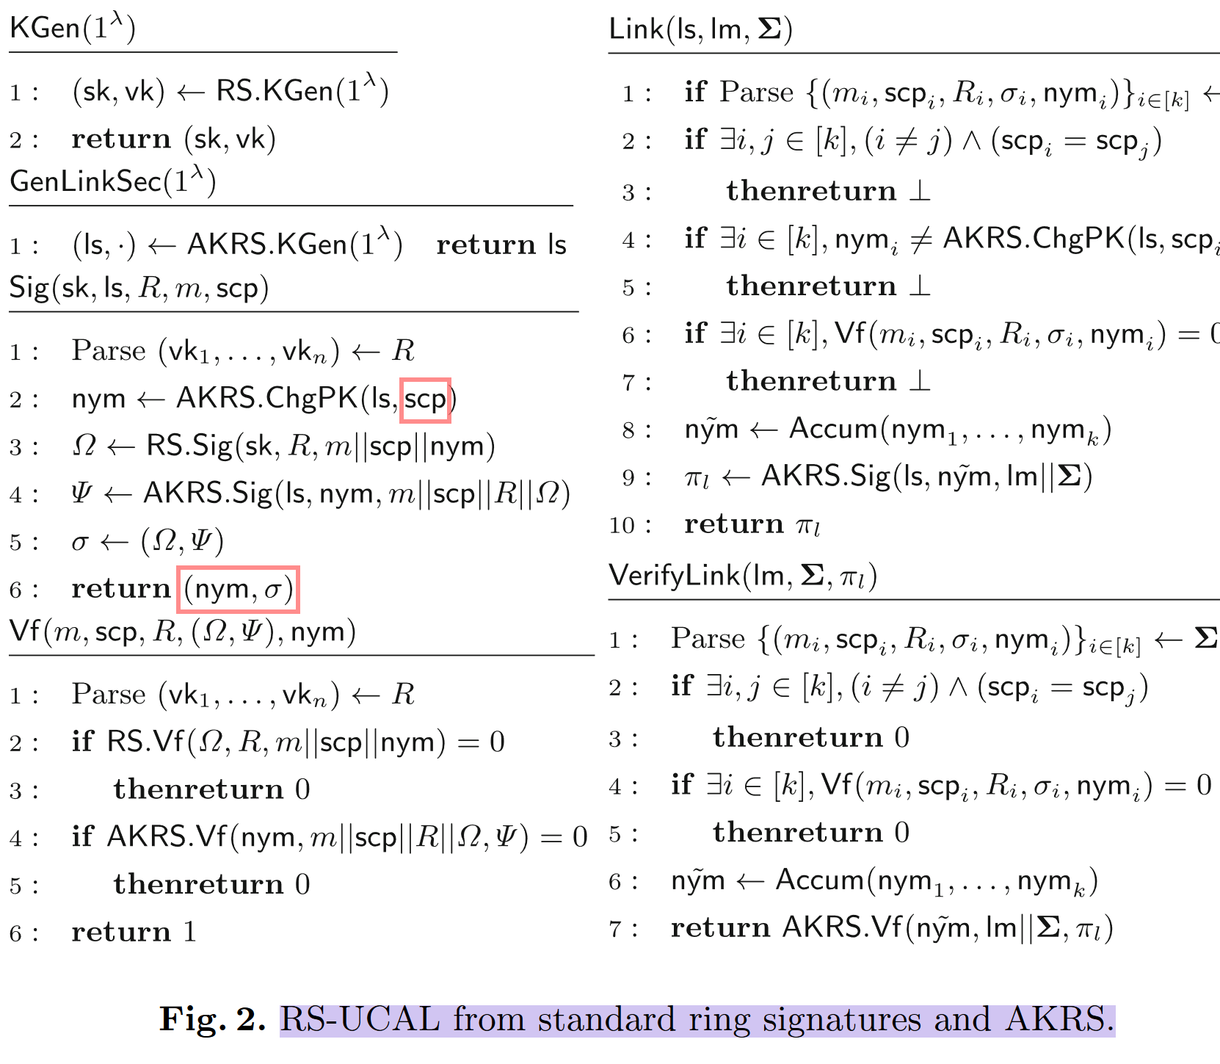
4.1RS-UCAL

Slide 30
4.2RS-UCL
构造二： RS with user controlled linking

Slide 31
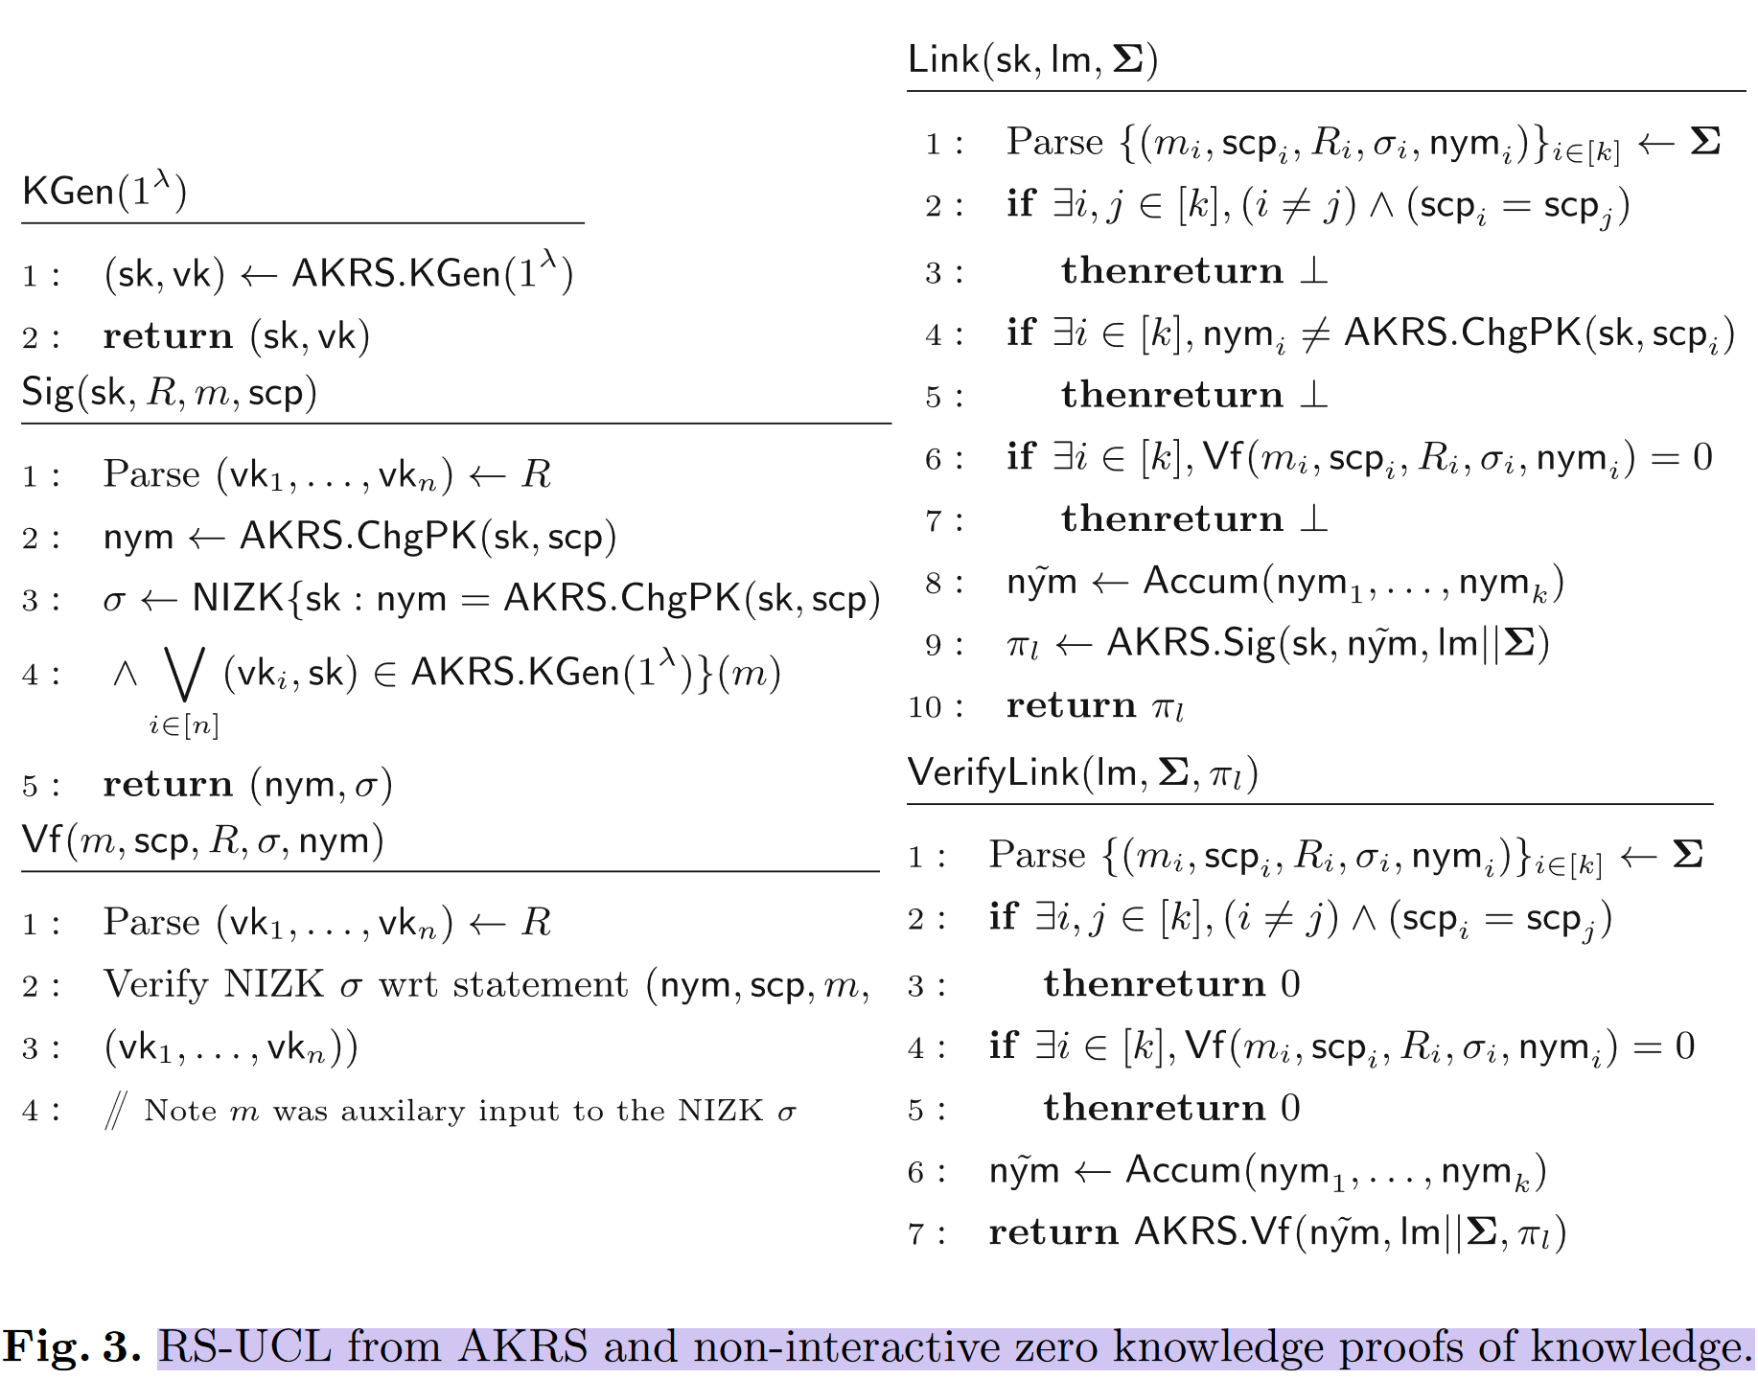
4.2RS-UCL

Slide 32
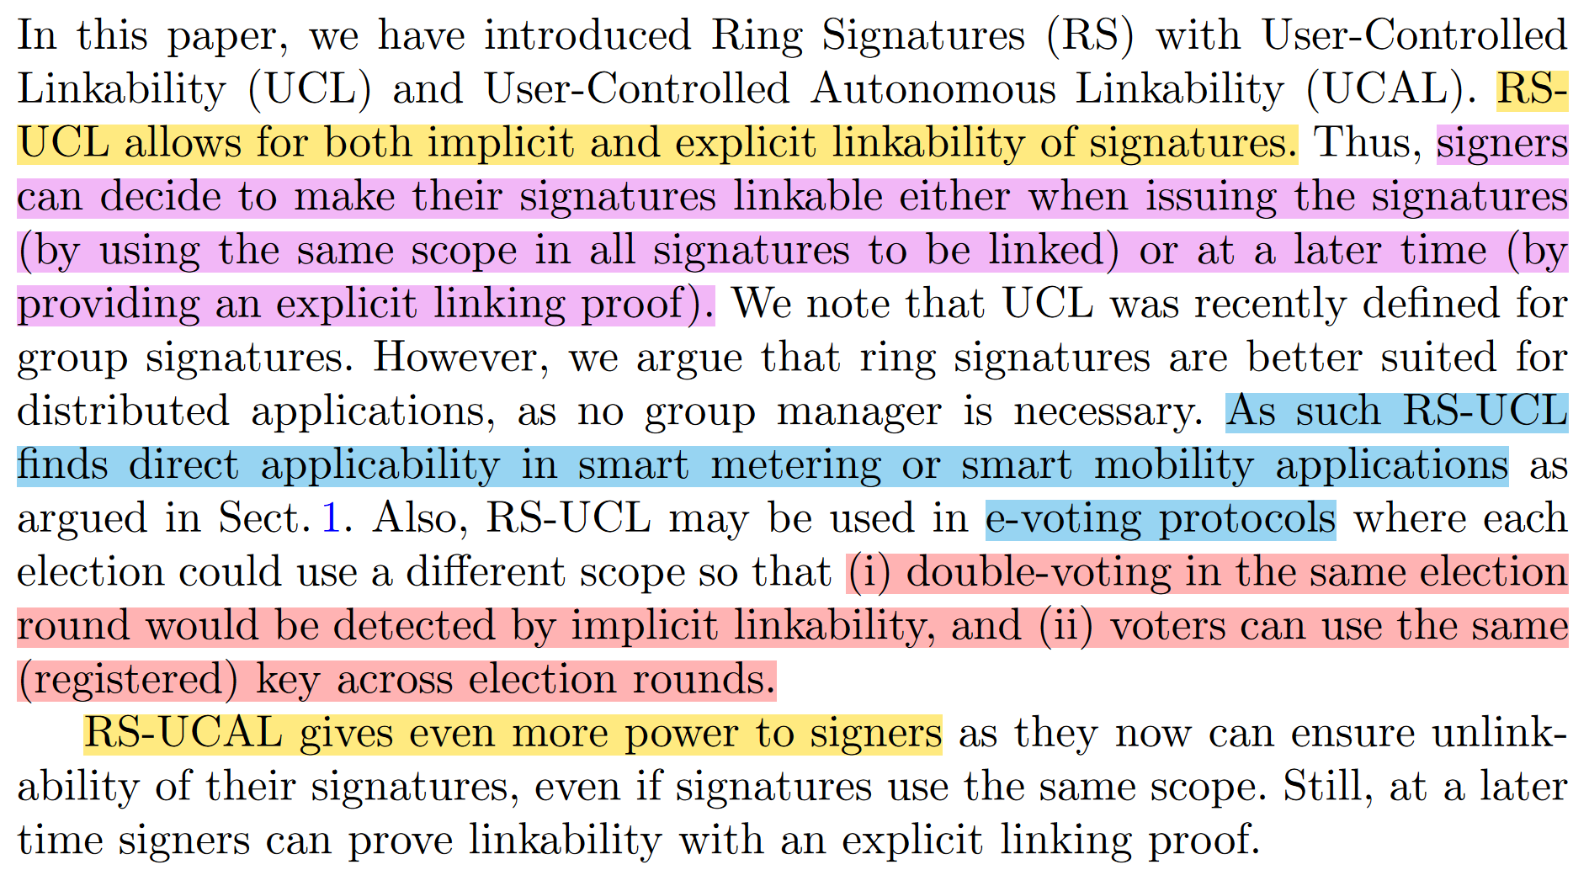
5Conclusions
Notes:
1.用户可链接→委托人可链接--》所有人可链接（特定签名）

Slide 33
THANK YOU!
Questions?

